Slide 1
Recycling, Reusing, Reducing: What’s the difference?

Slide 2
What do you know about recycling?

Slide 3
Recycling
Re-processing material to make another product
Notes:
Taking material in one form & re-processing it to make another product

Slide 4
What do you know about reusing?

Slide 5
Reusing
Use product in original form, but in new way.
Notes:
Using a product in a different way in its original form. So, a shoe box or a coffee can can become storage containers.

Slide 6
What do you know about reducing?

Slide 7
Reducing
Reduced (or more efficient) consumer use of materials

Slide 8
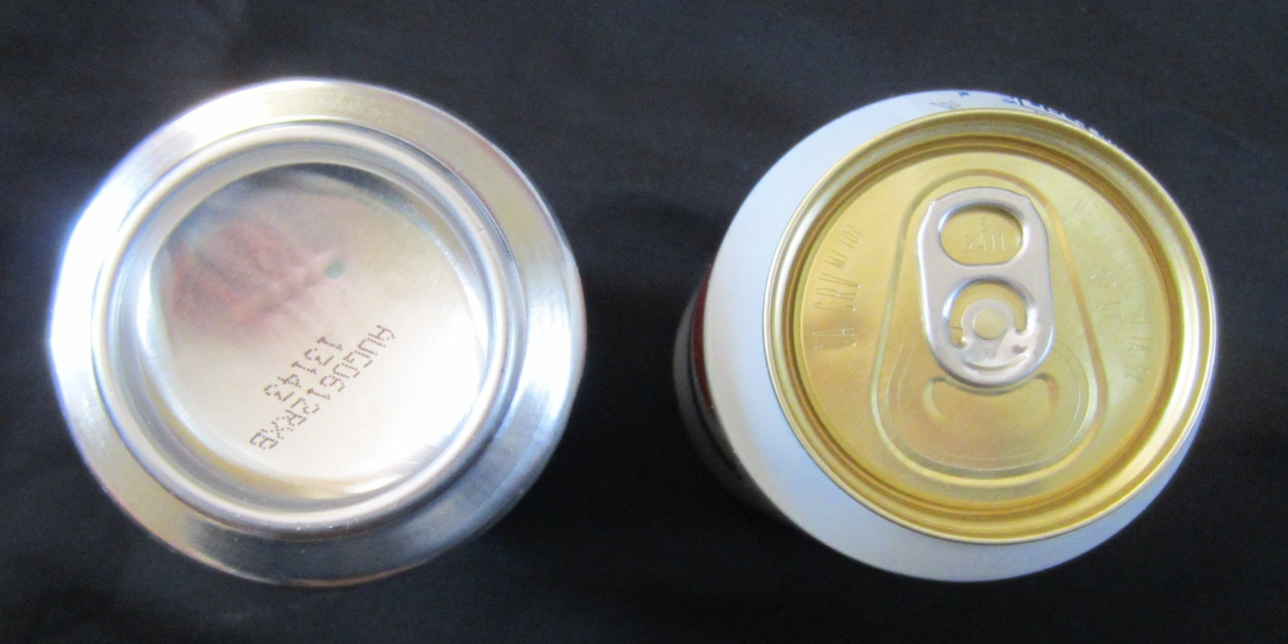
Reducing
Reduced material use in product manufacture

Slide 9
Reducing
Decreased toxicity

Slide 10
Reducing
Increased useful life through durability and repair-ability

Slide 11
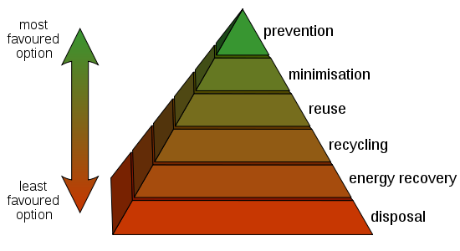
Reduction
Prevents the generation of waste. It’s the preferred—but often-overlooked—strategy.
Notes:
We’ve turned the hierarchy on its head.
Retrieved at http://en.wikipedia.org/wiki/File:Waste_hierarchy.svg

Slide 12
Reduce, Reuse, Recycle
The hierarchy has its limitations.
Production and consumption are far more important needs to address than disposal.
Notes:
The hierarchy focuses on disposal.
For every pound of waste consumers generate, about 70 pounds of waste is generated to get that product to us.

Slide 13
Where Does Our Trash Go?
On average…
31% Recycled
69% Landfilled
4.5 pounds of trash are produced per person per day

Slide 14
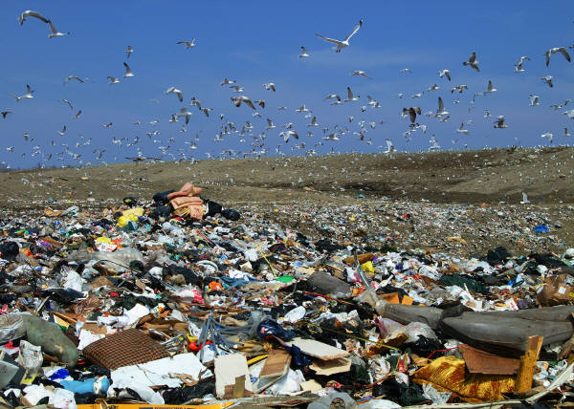
Dump vs. Landfill
Dump – a hole where trash is dumped
Landfill – a structured place where trash is deposited
Dump – a hole where trash is dumped
Landfill – a structured place where trash is deposited

Slide 15
U.S. History of Landfills
Before 1960’s
Most waste was burned in open dumps.
Produced clouds of smoke, a bad odor and created a breeding ground for flies and rats
Before and early 1960’s
Waste burned in incinerators and combustion facilities (high temperatures burn waste more completely than in open burns)
Prime sources of air pollution
1960’s and 1970’s
Laws passed regulating air pollution
1970’s
Dumps converted to full operating landfills.
1988-2001
Number of landfills decline from 8,000 to 1,858
Due to landfill size, recycling has increased, and regulations are tighter.

Slide 16
Landfill – Design and Function
Challenges of a Landfill
groundwater contamination from liquids produced in landfill
methane production from anerobic decomposition of trash
incomplete decomposition (newspapers in a landfill have been found to be up to 100 years old!)
as trash decomposes it compacts and settles causing landfills to sink
most neighborhoods oppose having a landfill built in their vicinity

Slide 17
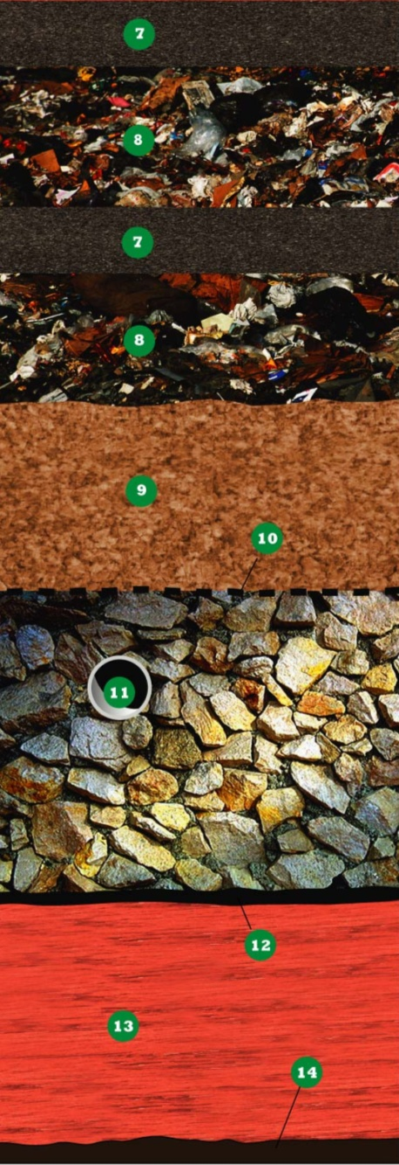
Anatomy of a Working Landfill
Daily Cover
At the end of each day, waste is covered with 6-12 inches of soil.
reduces odors
keeps litter from blowing away
deters scavengers/animals/rodents
Waste
Waste is compacted in layers to reduce its volume.
Sand/Gravel Layer
Collects liquid produced from waste and funnels it to the leachate pipe system below.
Leachate Pipe System
Pipes collect leachate and pump it out of the landfill and to a water treatment plant, retention pond, or another proper method of disposal.
Geomembrane – Plastic Layer
A thick plastic layer lines the landfills and prevents leachate from entering the ground. The plastic is made from high-density polyethylene which is tough and impermeable.
Clay Layer
Compacted clay is first laid in the landfill space to form a barrier to prevent leachate leaks to protect the soil and hold the trash in place. Clay is used due to its moldable and impermeability qualities.

