Slide 1
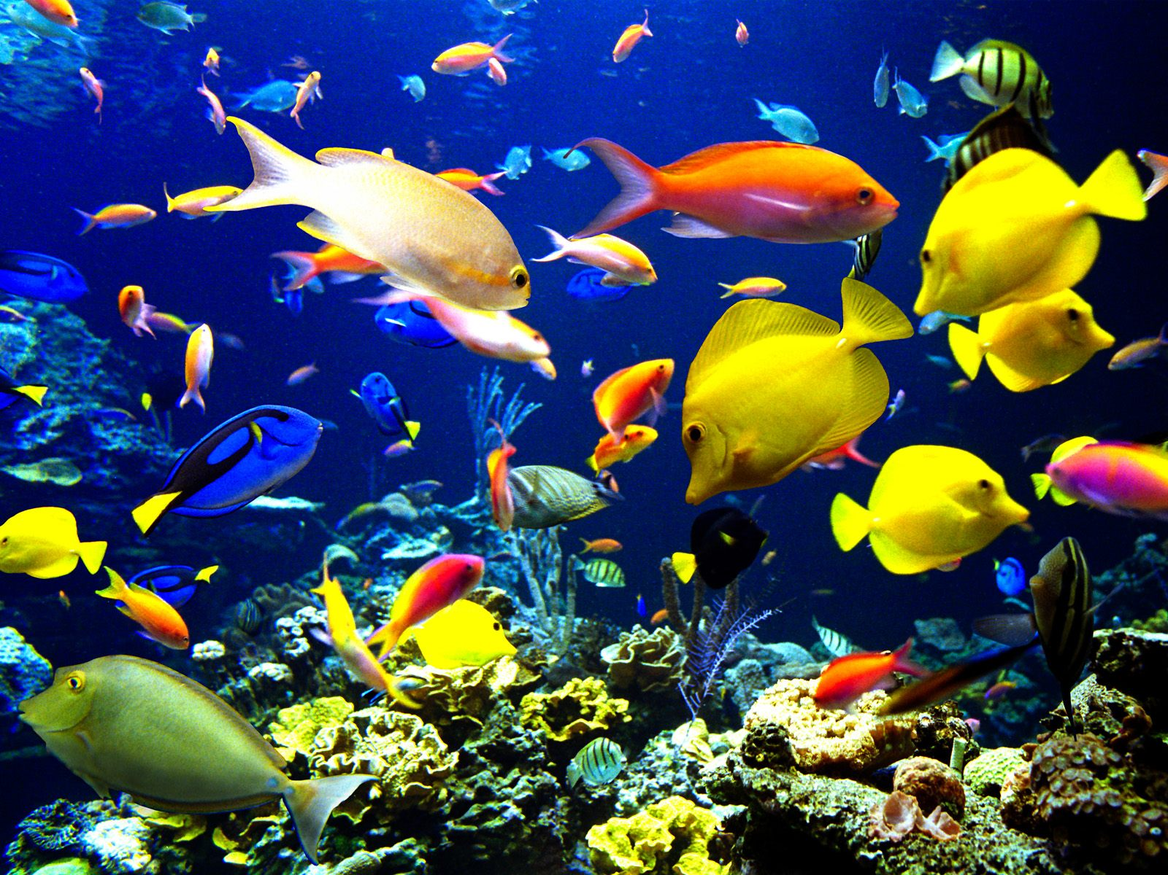
Life in the Oceans

Slide 2
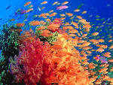
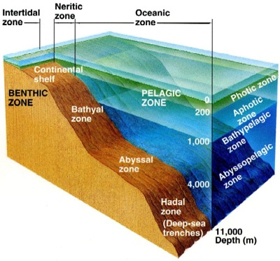
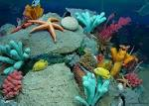
The Diversity of Ocean Life
Classification of Marine Organisms: Marine organisms can be classified according to where they live and how they move.

Slide 3
Marine Ecosystems
Some of the most diverse marine ecosystems are:
Estuaries - body of water formed where freshwater from rivers and streams flows into the ocean, mixing with the seawater
Coral reefs – underwater community found near the surface of tropical waters formed by skeletal deposits of corals

Slide 4
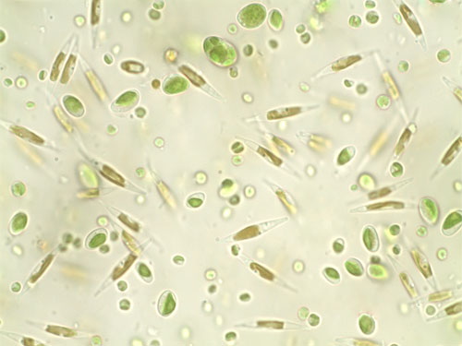
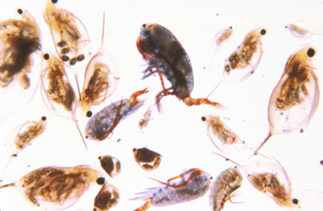
Plankton: All organisms (algae, animals and bacteria) that drift with the ocean currents.
Phytoplankton are free-floating,
microscopic plants.
Phytoplankton perform
photosynthesis.
Zooplankton are free floating, microscopic animals.
Zooplankton eat phytoplankton.

Slide 5
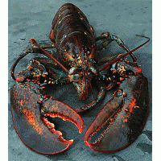
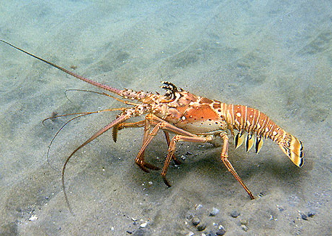
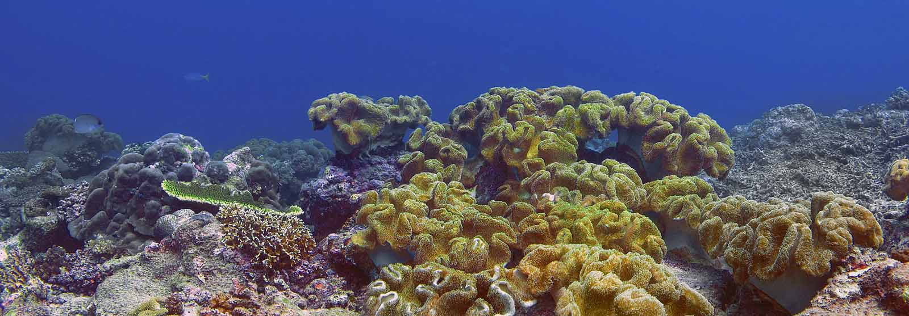
Benthos are any form of ocean life that live on the ocean floor.

Slide 6
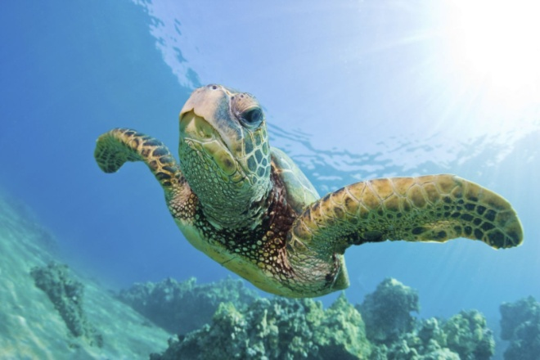
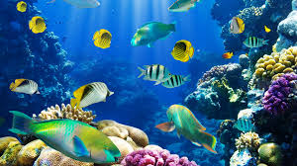
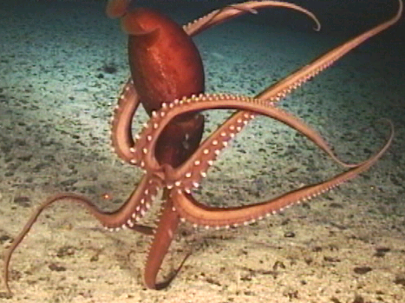
Nekton (nektos = swimming): Animals capable of moving independently of the ocean currents by swimming or other means of propulsion. Ex. Adult fish, squid, marine mammals and reptiles

Slide 7
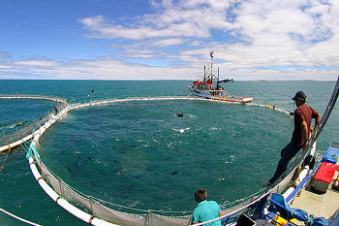
Food from the Ocean
Aquaculture – the sustainable farming of marine life.
Catfish, salmon, oysters, and shrimp

Slide 8
Aquaculture
Traditional
Sustainable
Land-based to ocean-based cultivation
Fishing
Trawling
Substantial contributions to food supplies
Release organic waste
Destruction of coastal ecosystems
Land-based to ocean-based cultivation
Fishing
Limits to catches
Plant-based feeds
Does not negatively affect wildlife
Supports long-term economic and social well-being of local communities
Notes:
http://www.greenpeace.org/international/en/campaigns/oceans/sustainable-aquaculture/

Slide 9
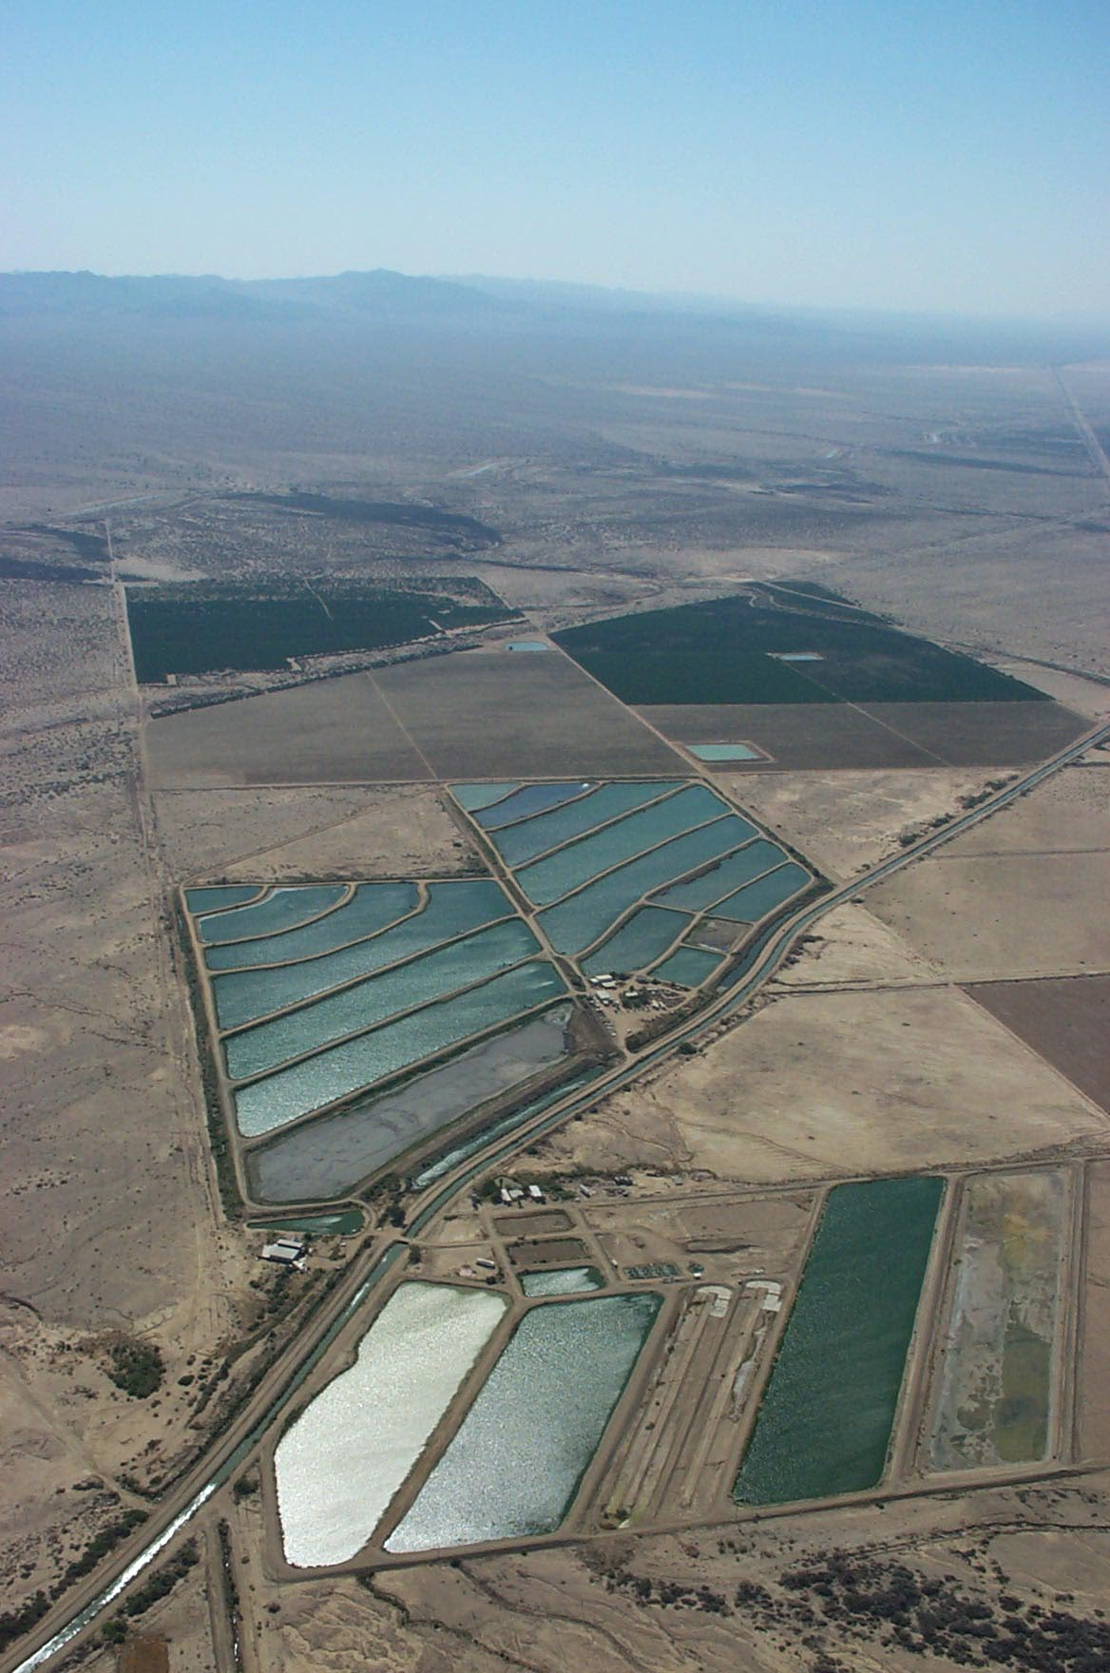
Shrimp Farm
Arizona
Catfish Farm
California

Slide 10
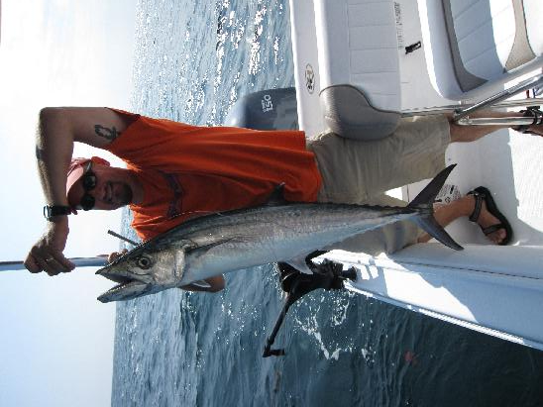

Slide 11
