Slide 1
Air Pressure and Wind

Slide 2
What is air pressure?
Air Pressure: the force exerted by the weight of the air above it
Why does the weight of the air not crush you?
The pressure is exerted in all directions, not just down
(Ruler and newspaper demonstration)

Slide 3
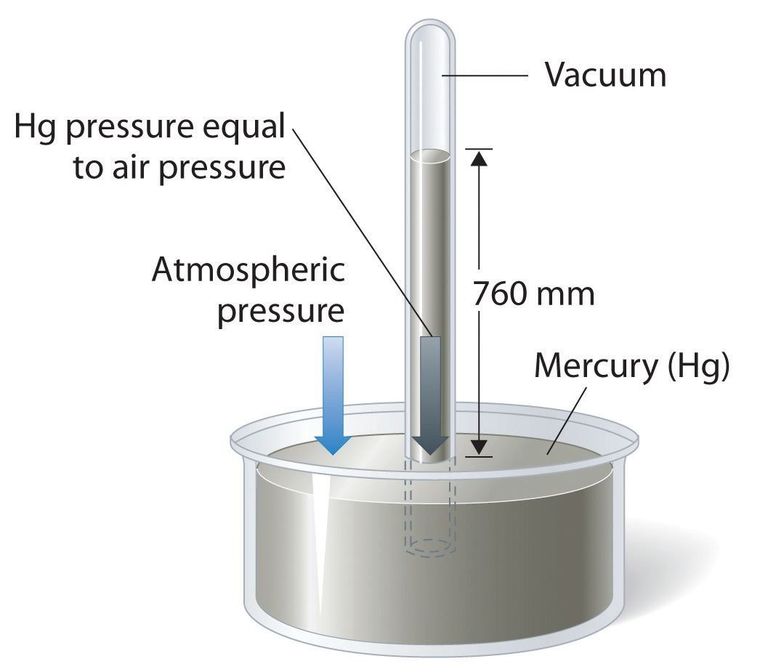
How to measure air pressure
Mercury barometer
Aneroid barometer
Pressure is measured in inches of mercury or pounds per square inch.

Slide 4
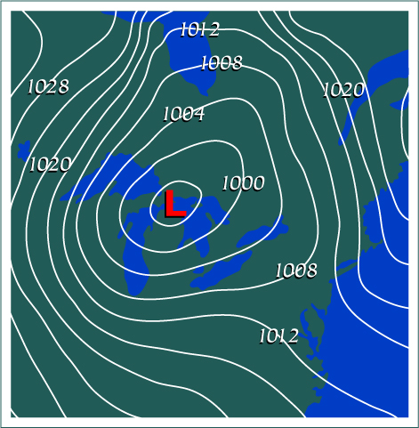
Isobars
Isobars are connected lines of equal pressure
The spacing between each isobar indicates pressure change

Slide 5
**Why does air pressure matter?
Why do places have different air pressures?
Solar radiation creates air pressure differences
This difference in air pressure causes a phenomena called wind.
Wind is when air flows from areas of high air pressure to areas of low air pressure

Slide 6
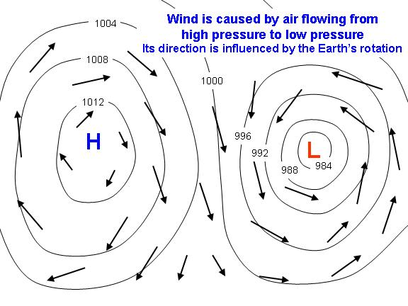
High and Lows
Areas of Low pressure are characterized by:
Hot Air Rising
This leads to clouds and precipitation
Due to coriolis winds rotate in a counter-clockwise motion
Low Pressure = Cyclone
Areas of High pressure are characterized by:
Cold Air Sinking
winds blowing away in clockwise motion
High Pressure = Anti-cyclone

Slide 7
Factors of Wind
What makes some places windier than others?
Two factors:
Pressure differences
Coriolis Effect

Slide 8
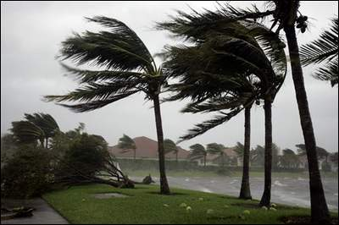
Pressure Differences
Wind is caused by differences in air pressure.
The greater the difference the greater the wind speed.
By looking at your isobars the closer the lines are together, the steeper the pressure gradient (changes in pressure)
Close Isobars= High Winds
Widely Spaced Isobars= Low Winds

Slide 9
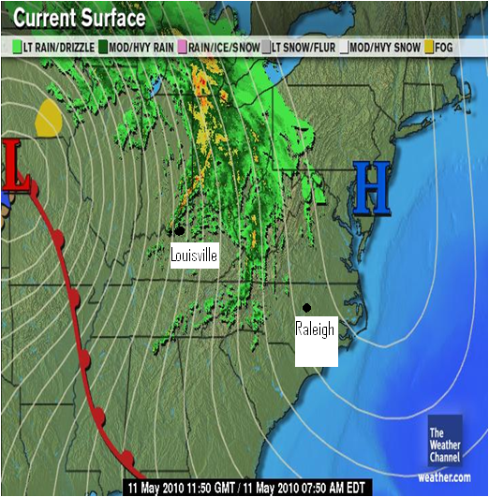
Where is it windier, Raleigh NC or Louisville KY?

Slide 10
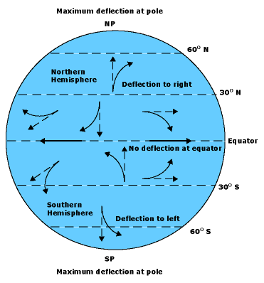
Coriolis Effect
The rotation of the Earth deflects wind direction
In the Northern Hemisphere to the right
In the Southern Hemisphere to the left.
The faster you move the stronger the effect
http://techtv.mit.edu/videos/3714-the-coriolis-effect

Slide 11
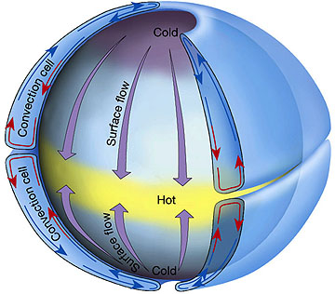
Global Winds
Winds caused by uneven heating of Earth’s atmosphere. Equator gets more sunlight,
Equatorial air expands, rises and flows toward poles
Polar air is denser so it flows toward the equator
Non-rotating Earth, 2 cells(North & South) ->

Slide 12
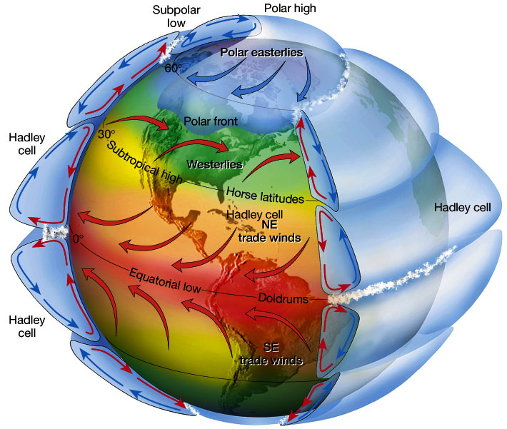
Rotating Earth
Due to the Earth rotation, instead of two cells you have six.
Why do we have six?
High pressure around 30 and low pressure around 60
High Pressure Sinks
Low Pressure Rises
Three winds in each hemisphere
Trade – blow from east
Westerlies – blow from west
Polar Easterlies – blow from east

