Slide 1
NC Geology

Slide 2
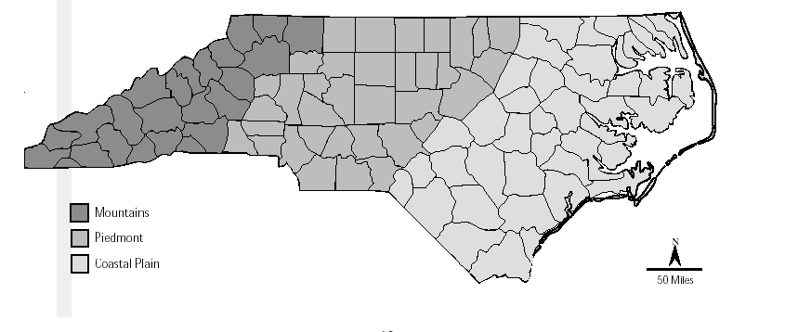
Regions of NC
North Carolina can be subdivided into specific regions.
Mountains
Piedmont
Coastal Plain

Slide 3
Mountains
The mountains of NC are known as the Blue Ridge Mountains, part of the Appalachian Mts
Known for their blue hue
Created from the collision of North America into Europe
Started growing around 400 mya (Paleozoic Era)
Stopped growing around 270 mya

Slide 5
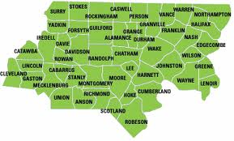
Piedmont
Piedmont- Italian word for “foot of the mountain”
Area less steep than the mountains but steeper than the coastal plain.
Created by weathering and erosion of mountains

Slide 6
Fall Zone
The fall zone is the boundary between these two different types of bedrock.
Piedmont and Coastal plains contain different types of bedrock.
Piedmont is Metamorphic
Coastal Plain is Sedimentary

Slide 7
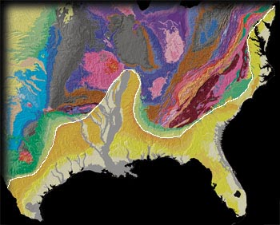

Slide 8
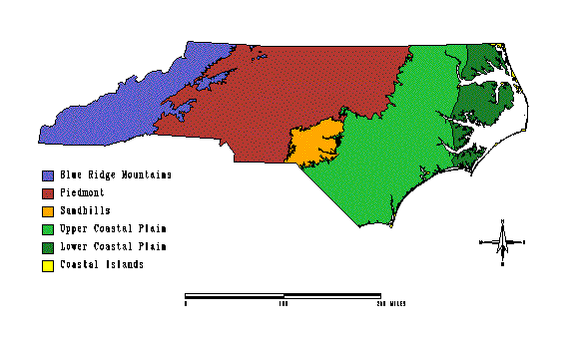
Coastal Plain
Flatter than the piedmont. Divided between inner and outer coastal plain regions
Inner Coastal plain is steeper and dryer than the outer coastal plain
Contains Sandhills Region
Outer coastal plain contains swamps and outer banks
Created from weathering by tides over time

Slide 9
NC Geologic Timeline
1.7 BYA – NC land forms
444 MYA – NC and Europe begin to collide
320 MYA – Pangaea forms with NC in heart
250 MYA – Pangaea breaks, Mountains start to weather
145 MYA – Oceans recede, Coastal plain visible
145 Mya – present: ocean advances and recedes multiple times

Slide 10
