Slide 1
What runs but never walks,
Has a mouth but never talks,
Has a bed but never sleeps,
Has a head but never weeps?

Slide 2
River Basics

Slide 3
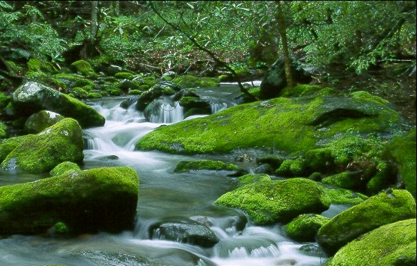
River Basics
Rivers and Streams are areas where the water table meets the earth’s surface

Slide 4
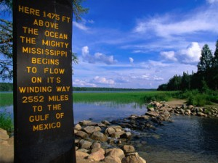
Headwaters
Beginning of a river
Usually found in the mountains
Runoff from mountains flow into valleys, valleys become saturated
Flows to lowest point

Slide 5
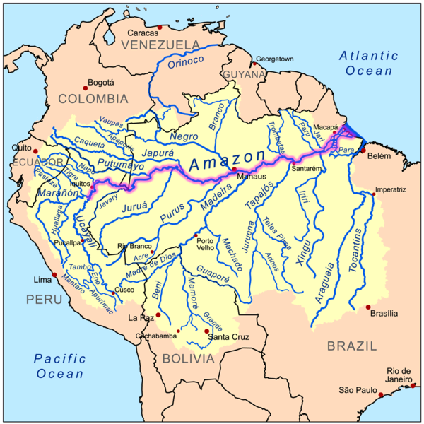
Tributaries
Smaller rivers that feed into a big river
More found in mountains than on flat land

Slide 6
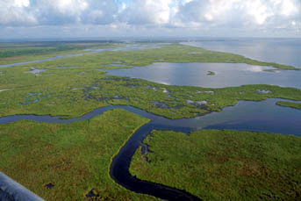
Mouth
Where the river flows into a larger body of water (lake, ocean, another river)

Slide 7
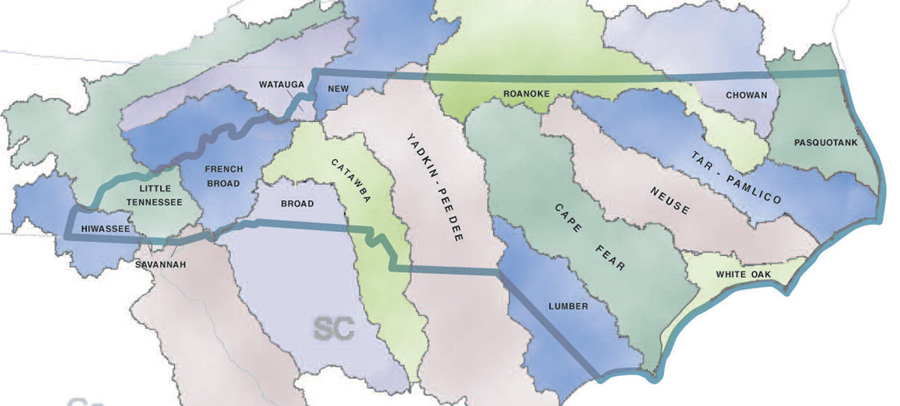
Rivers and Streams
Watershed/River Basin/Drainage Basin: A region of land that contributes water to a stream or river

Slide 8
Divide
Divide - boundaries that separate streams of adjacent watersheds

Slide 9
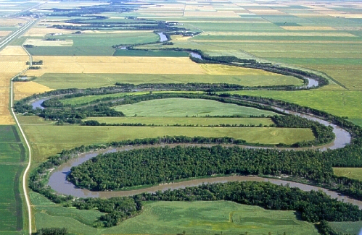
Channel
The course the water in a river or stream follows

Slide 10
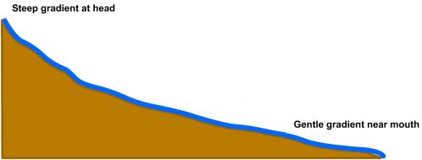
Gradient
The slope or steepness of a stream channel
Usually expressed as the vertical drop of a stream over a certain distance (change in elevation)

Slide 11
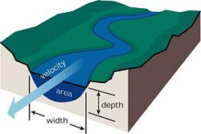
Discharge of a Stream
The volume of water flowing past a certain point in a given unit of time
Usually measured in cubic meters per second

Slide 12
What are the top 10 river discharges in the world?
1. Amazon . . . . . . . . . . . 175,000 cubic feet per second
2. Congo. . . . . . . . . . . . . 39,000
3. Yangtze. . . . . . . . . . . . 32,190
4. Plata-Parana-Grande. 22,900
5. Brahmaputra. . . . . . . . 19,200
6. Orinoco. . . . . . . . . . . . 18,000
7. Yenisey. . . . . . . . . . . . . 18,000
8. Missouri-Mississippi. 17,270
9. Lena. . . . . . . . . . . . . . . 16,100
10. Zambezi. . . . . . . . . . . 16,000

Slide 13
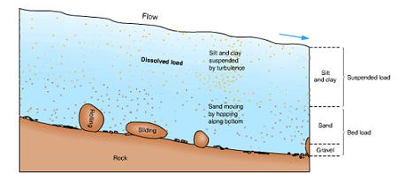
Stream Load
Stream load is the solid matter carried by a stream.
Erosion removes mineral material from the stream banks adding this material to the regular flow of water.

Slide 14
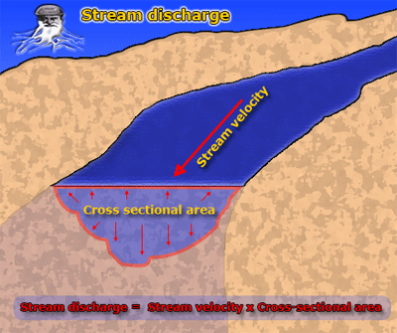
Stream load
Higher stream velocity equals higher stream load capacity—streams that move fast erode more and carry more sediment.

Slide 15
Stream Erosion and Deposition

Slide 16
Sediment Deposition
Sediment is deposited in a stream when there is a decrease in the speed of the water.
Speed may decrease because of:
Change in gradient
Bed widening
Obstructions
Stream deposition can create landforms or change the river valley

Slide 17
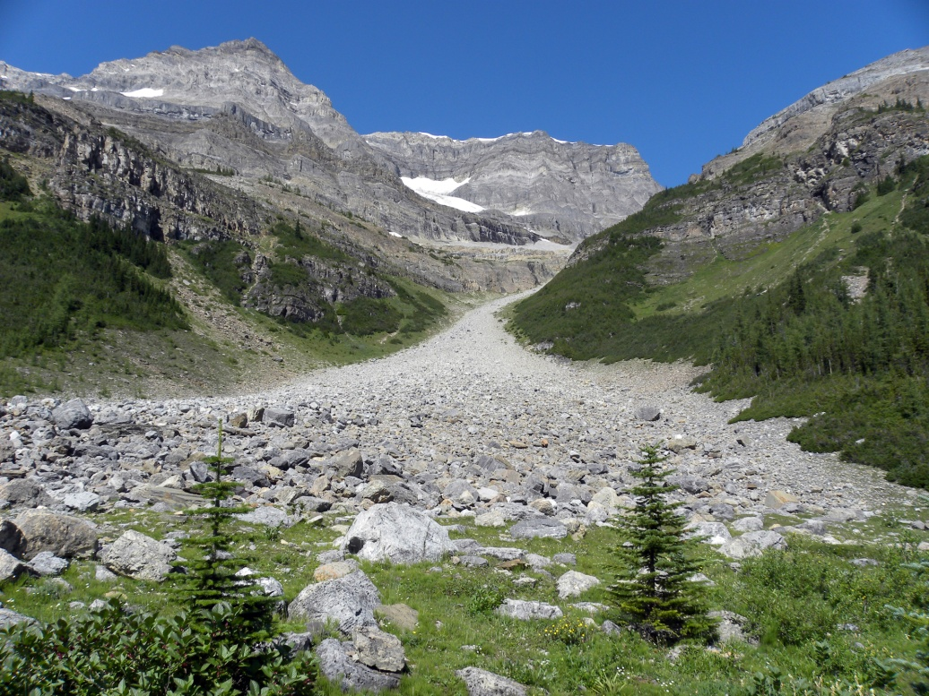
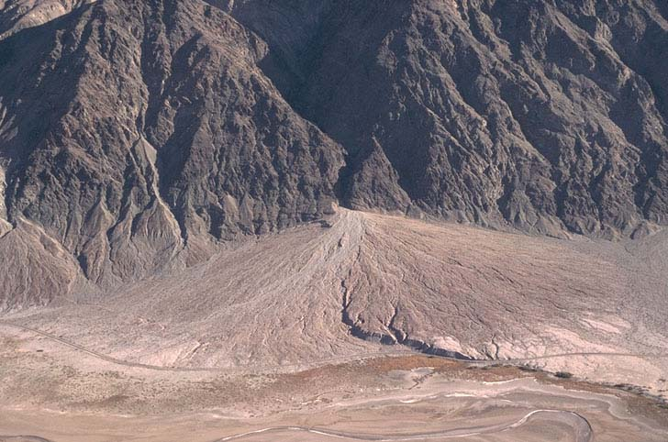
Alluvial Fan
Alluvial fan – sloping fan shaped deposit of sediments
Occurs where a stream descending a steep slope reaches flat land.

Slide 18
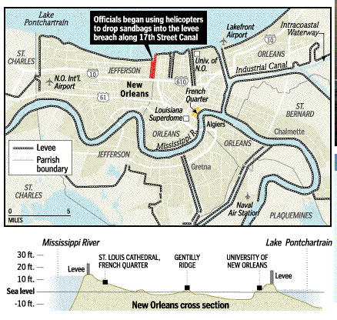
Levees
Natural Levees - raised river banks caused by flooding.
Artificial Levees - an embankment built to prevent the overflow of a river.

Slide 19
Floodplain
Floodplain: part of the valley floor covered with water during a flood
A floodplain forms where a stream cuts mainly side to side
Sediment is deposited making flood plains fertile.
Nile River Floodplain

Slide 20
Flooding Precautions
Artificial levees
Flood insurance if you own a home in a high-risk area
Be prepared to evacuate if need be
Limit floodplain development
Why limit floodplain development?
Allows floodplains to absorb floodwaters
Prevents structures from being put in harms way

Slide 21
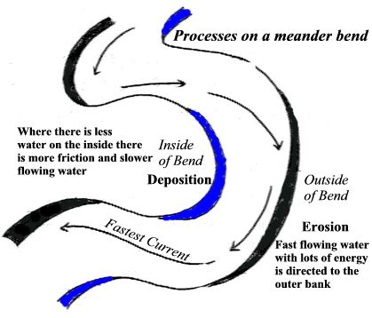
Meander
Meanders – curves in a river caused by an obstruction;
Erosion occurs on outside of a bend
Deposition occurs on the inside of a bend.

Slide 22
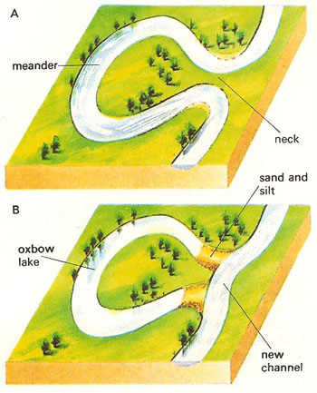
Oxbow Lake
Oxbow Lake – crescent shaped body of water resulting when a part of a meander is cut off and abandoned by the river.

Slide 23
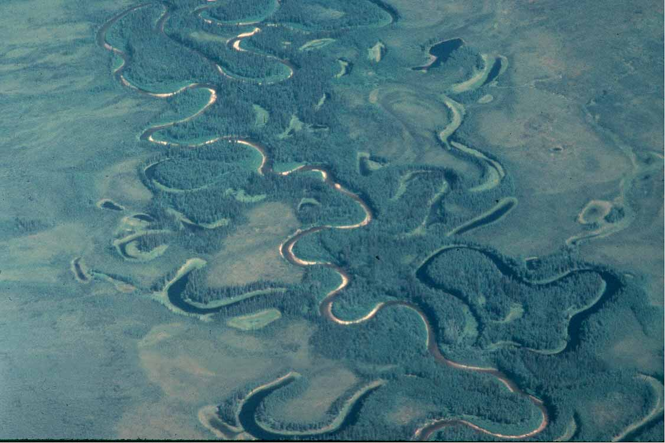

Slide 24
Stages of development of a river:
Young river- V-shaped channel with steep sides
Mature river: U-shaped channel with more sloping sides and some meanders
Old river: flatter U-shaped channel with sloping sides, lots of meanders, and oxbow lakes

Slide 25
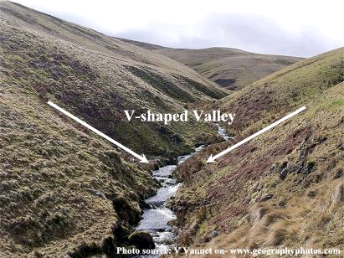
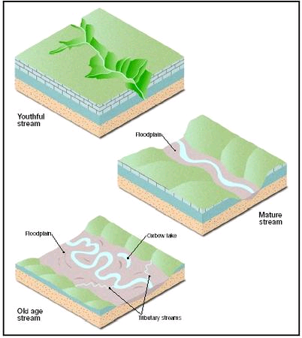
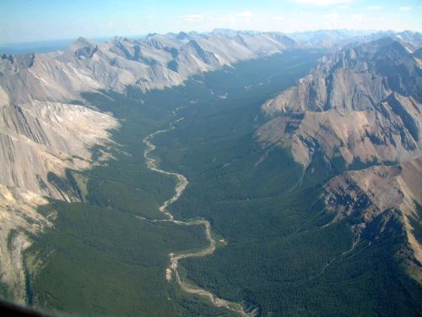

Slide 26
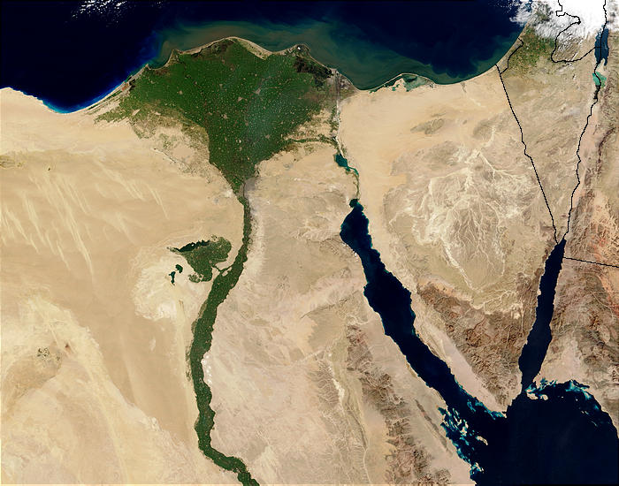
Delta
Delta – depositional feature of built up sediment that forms where a stream enters a lake or ocean
Occurs because the water slows down as it is emptied into another body of water.
Nile River Delta

Slide 28
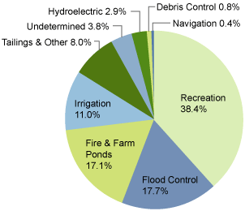
Dam - a barrier to obstruct the flow of water
Increase accumulation of sediment in water
Expensive to build
Destruction of natural habitat for plants and animals
Storage place for water
Hydroelectric power
Recreational facilities
Irrigation
ADVANTAGES
DISADVANTAGES

Slide 29
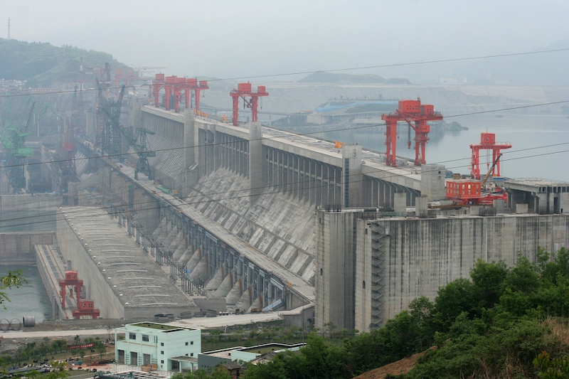
Three Gorges Dam on the Yangtze River in China

Slide 30
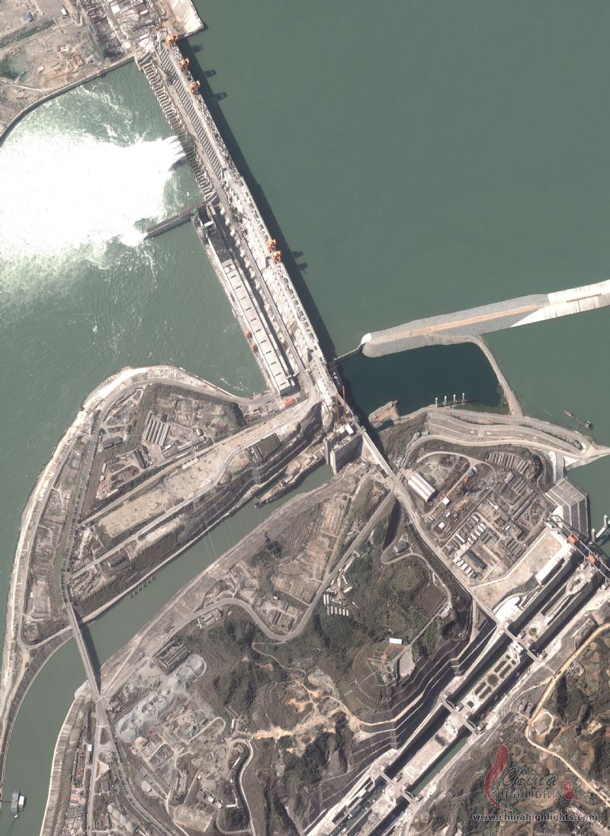
Three Gorges Dam – largest hydroelectric in the world

Slide 31
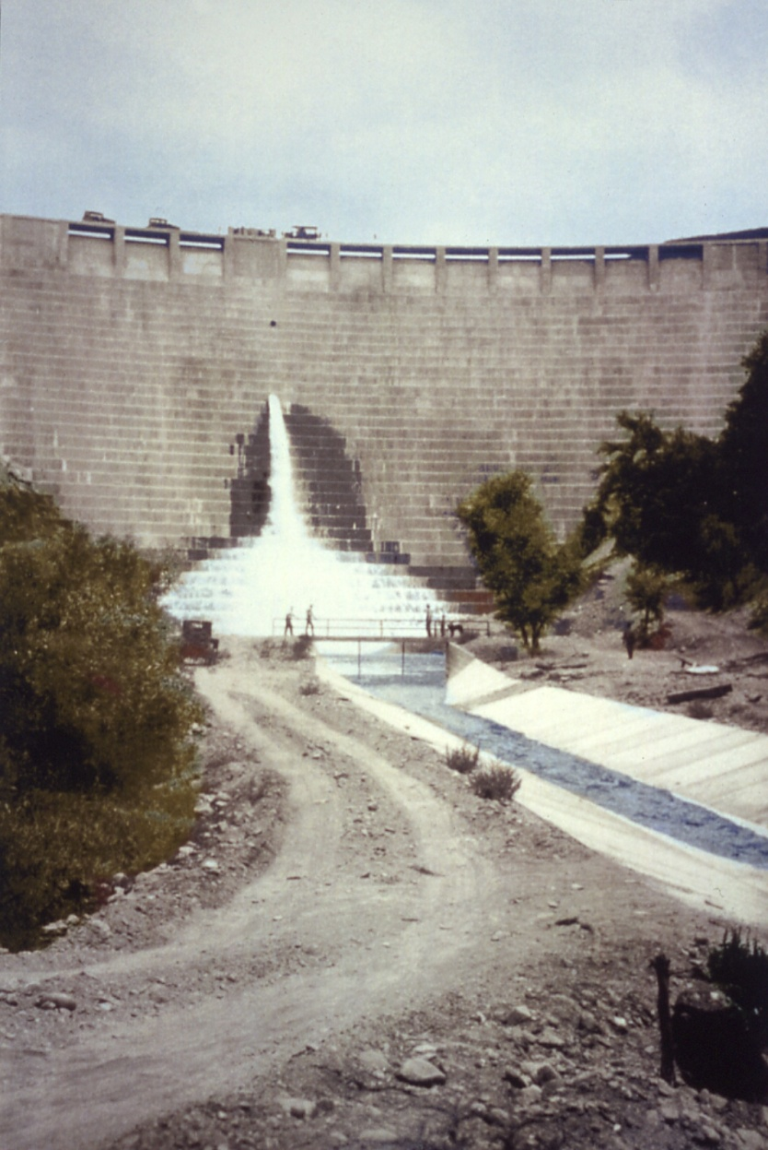
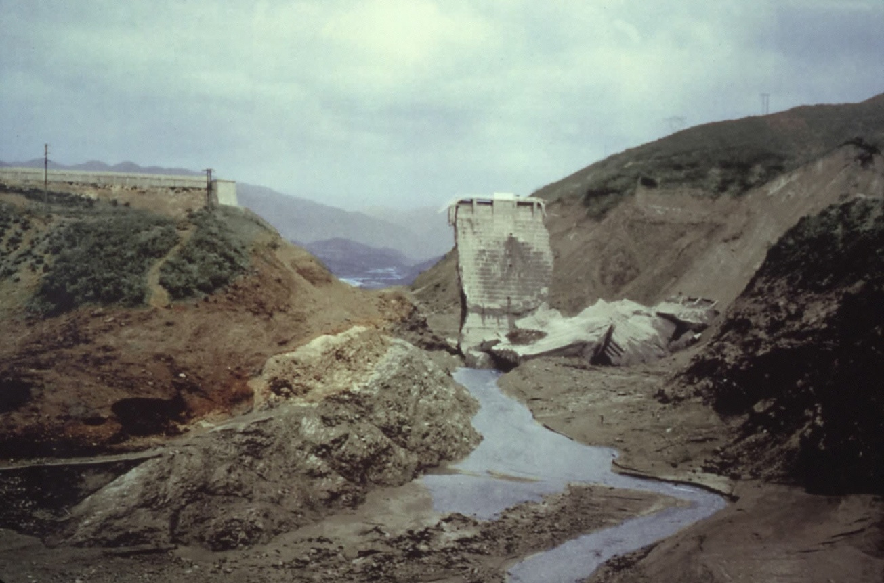
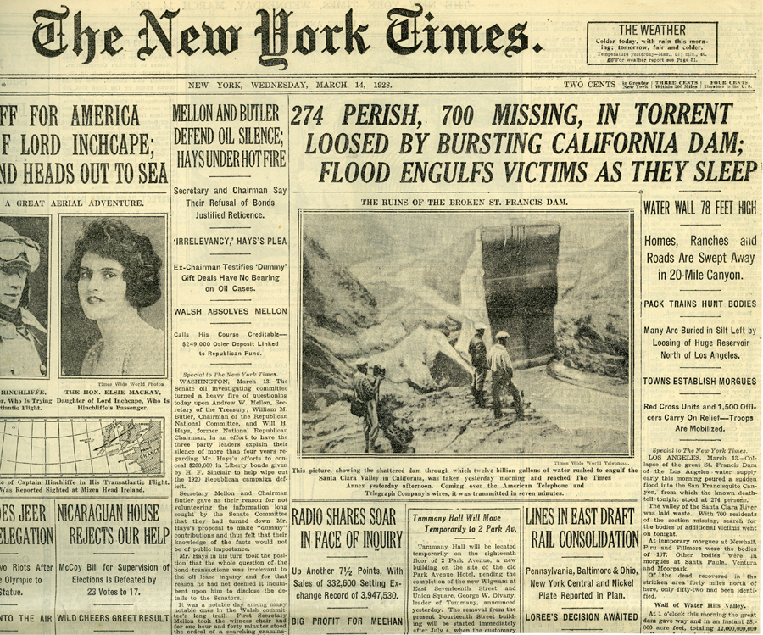
St. Francis Dam Disaster - 1926

Slide 32
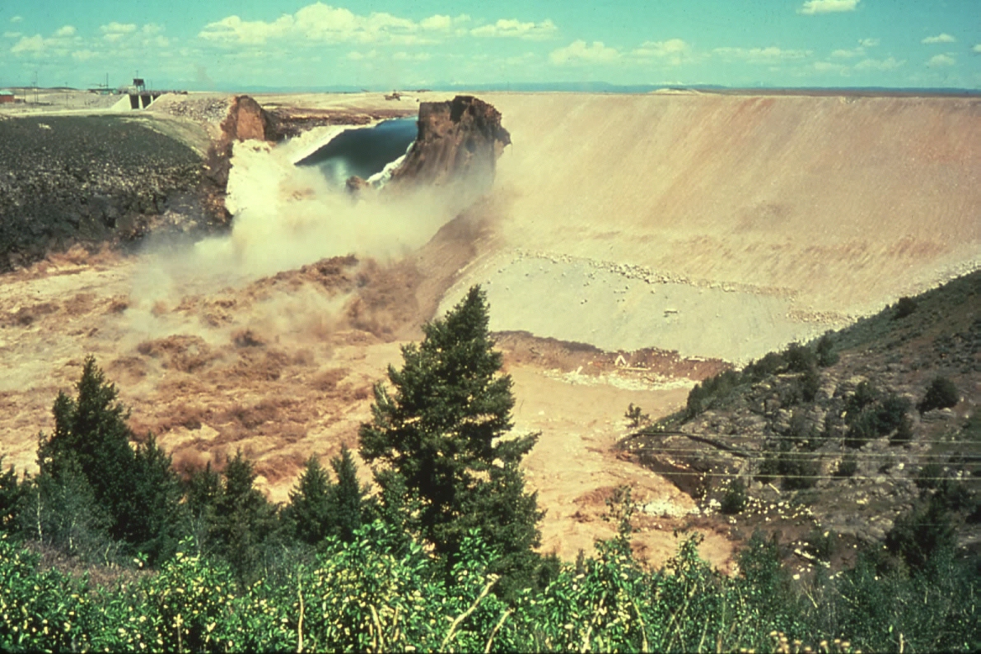
Failure of Teton Dam - 1976
https://www.youtube.com/watch?v=cdOGPBnfoKE

