Slide 1
Metric System
Notes:
http://www.youtube.com/watch?v=gdmz3O2lnMQ

Slide 2
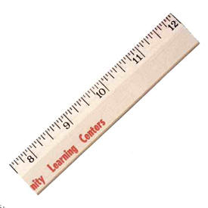
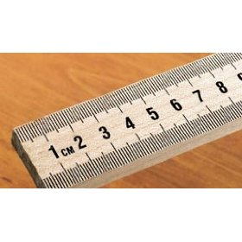
The metric unit for length is the meter.
Length can be measured by a ruler or meterstick.
Ruler (inches)
Meterstick (centimeters)
Notes:
http://www.saveonpromotionalproducts.com/catalogpics/AAkron_Line/112lg.jpg
http://ecx.images-amazon.com/images/I/31d6FxY28fL._SL500_AA280_.jpg

Slide 3
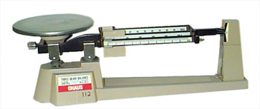
Mass
The amount of matter in an object.
The metric unit for mass is grams.
Mass is usually measured by a scale.
Notes:
http://www.physics.smu.edu/~scalise/apparatus/triplebeam/triplebeam.jpg

Slide 4
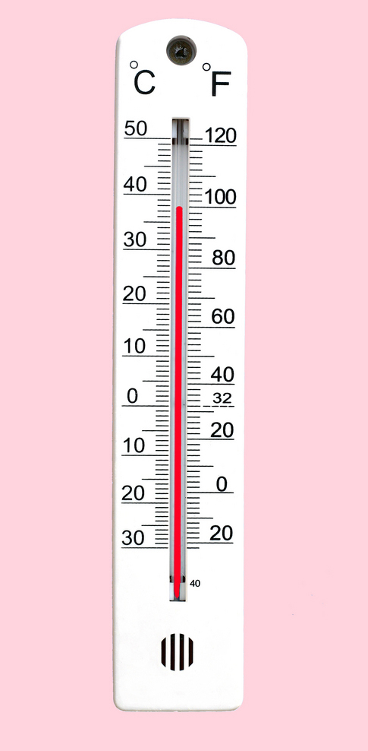
Temperature
The metric unit for temperature is Celsius.
The freezing and boiling points of water on this scale are 0º C (32ºF) and 100º C (212ºF).
Notes:
http://www.biglearning.org/photo-thermometer.jpg

Slide 5
The formula for converting C to F is:
F = 9/5 C + 32
The formula for converting F to C is:
C = 5/9 F-32

Slide 6
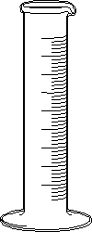
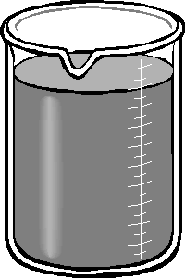
Volume
The amount of space that a substance fills.
The metric unit for volume is the liter or cubic centimeters.
The volume of a solid can be found using the water displacement method or the equation length x width x height
Notes:
http://www.msnucleus.org/membership/html/k-6/as/scimath/3/assm3_5a.html

Slide 7
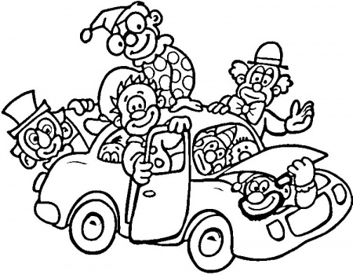
Density
The ratio of the mass of a substance to its volume.
Calculated using the following formula:
D = m/v
The metric unit for density is g/cm3 or g/mL
The density of pure water is 1 g/mL
Notes:
http://www.supercoloring.com/wp-content/main/2010_05/clowns-in-a-car-coloring-page.jpg

Slide 8
True or False
Density is the ratio of the mass of a substance to its volume.
The metric unit for length is the inch.
Volume is the amount of space a substance fills.
The metric unit for temperature is Fahrenheit.

Slide 9
Conversions
Prefixes in order from largest to smallest:
King
Henry
Died
Unusually
Drinking
Chocolate
Milk.
Prefix | Number Equivalent of basic unit
Kilo | 1000
Hecto | 100
Deka | 10
(basic) Unit | 1
Deci | 0.1
Centi | 0.01
Milli | 0.001

Slide 10
Moving the Decimal (Metric) Ex. 2m -> __km
Step 1: Write Saying
King
Henry
Died
Unusually
Drinking
Chocolate
Milk
Step 2: Identify where you are (2m).
Step 3: Identify where you want to go (__km)
Step 4: How do you get there? (Right or Left, How many spaces?)
Answer: 2 m -> ____km

Slide 11
Conversions
1) 2000 mg = _______ g
2) 104 km = _______ m
3) 480 cm = _____ m

Slide 12
Converting Standard Units
In the box method, we always make sure our units cancel, because of this ALWAYS WRITE YOUR UNITS!!!!!!!!!!!!!
Problem 3 ft -> __?__ in (1ft = 12 in) ?
Step 1: Draw Box
Step 2: Put starting measurements in top left
Step 3: Set up so units cancel
3 ft
3 ft | 12 inches
 | 1 ft

Slide 13
Scientific Notation
When dealing with large or small numbers we use a trick to save time.
Scientific Notation: A short hand method of writing numbers as multipliers and powers of 10.
Ex. Large Number
1,000,000.00 has six zeroes to the right of the decimal so it can be represented as 1.0 x10⁶

Slide 14
Scientific Notation Continued
Ex. Small Number
.00000056 is the same as 5.6 x 10⁻⁸
You try
1,400,000,000 = _______ x 10 ____
.000037 = _______ x 10____

