Slide 1
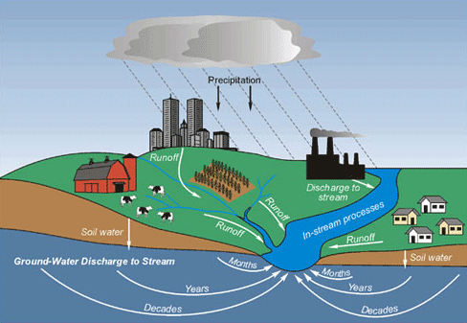
Groundwater
Ground water is water under the lands surface often stored in saturated pores of soil or rock.

Slide 2
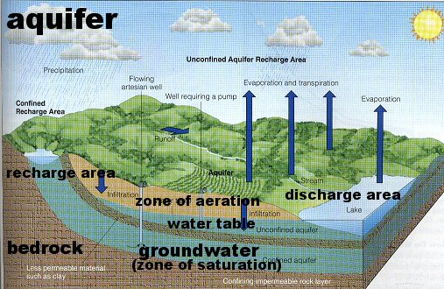
Aquifer
Permeable rock layers or sediments that transmit groundwater freely
Important source of well water

Slide 3
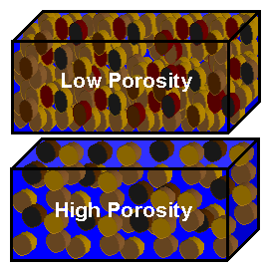
Porosity
Percentage of the total volume of rock or sediment that consists of pore spaces
Sorting: Rocks can be sorted into porous or non-porous

Slide 4
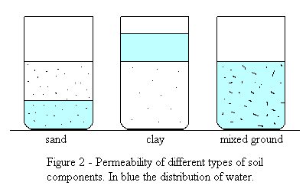
Permeability
A materials ability to transmit fluids through interconnected pore spaces
Groundwater moves more slowly when the pore spaces are smaller
Ex: Fine clay is impermeable because its pore spaces are so small water can’t move through them

Slide 5
Zone of Aeration
The region between the earth's surface and the water table.
Water Table - the level below which the ground is saturated with water
A high water table during periods of heavy rainfall or rapid snow melt can lead to flooding
Since the ground is already saturated (full of water), no more water can infiltrate into the ground which leads to flooding!

Slide 6
Zone of Saturation:
Area where water fills all of the open spaces in sediment and rock
Groundwater is within this zone

Slide 7
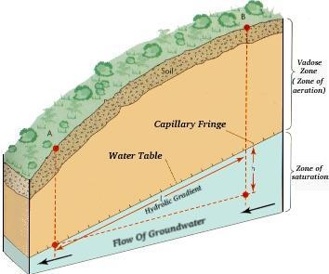

Slide 8
Groundwater and surface water interact through wells and springs

Slide 9
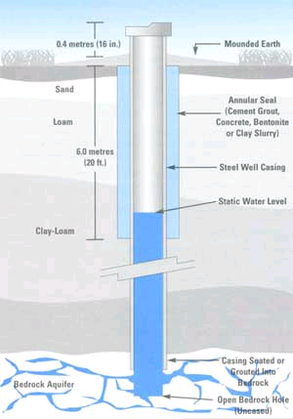
Wells
Ordinary Well: a hole that is dug below the water table and fills with groundwater.
Pumping is necessary
Several wells drilled in a given area will deplete the groundwater

Slide 10
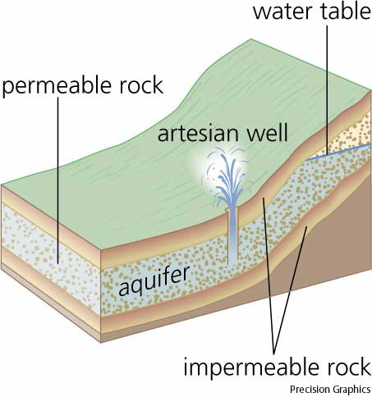
Wells
Artesian Well: Groundwater rises on its own under pressure out of well.
The pressure is due to the water being sandwiched between two impermeable rock layers
No pumping is necessary!

Slide 11
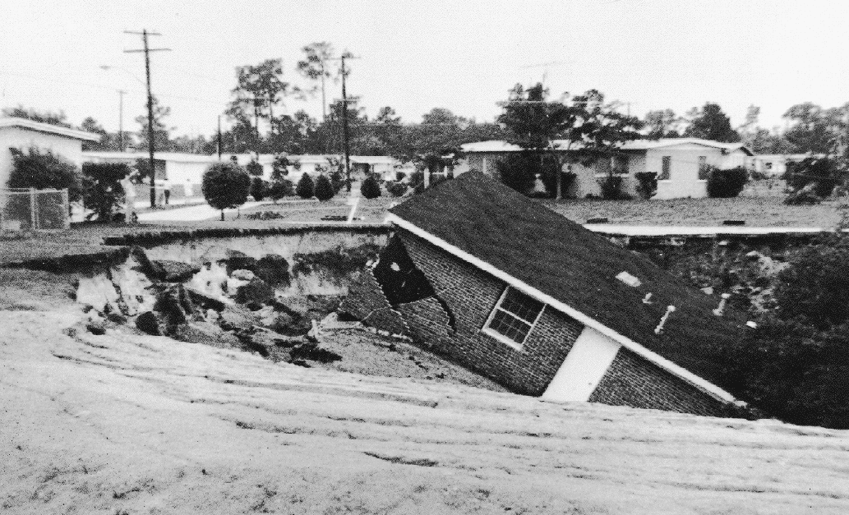
Subsidence
Subsidence is the sinking of the Earth's surface in response to geologic or man-induced causes.
Caused by pumping water out of the ground.

Slide 12
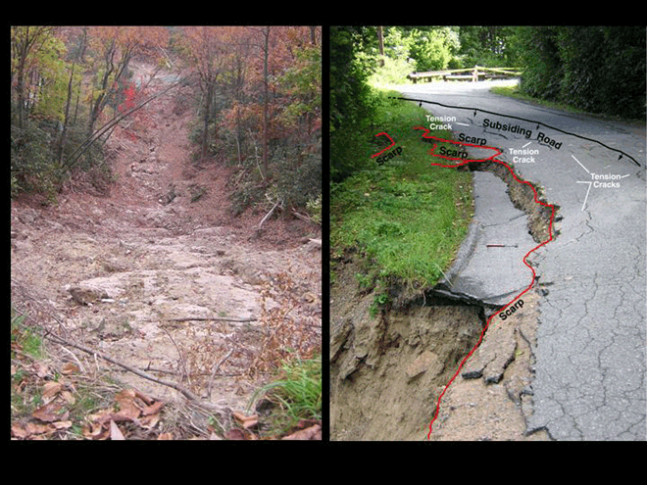
Why is subsidence an issue for North Carolina?
It can lead to the destruction of property and habits.

Slide 13
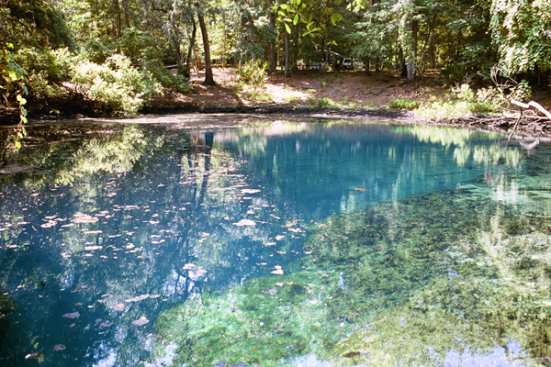
Springs
Springs: a section of impermeable rock forces groundwater to move laterally and emerge onto the surface of the Earth

Slide 14
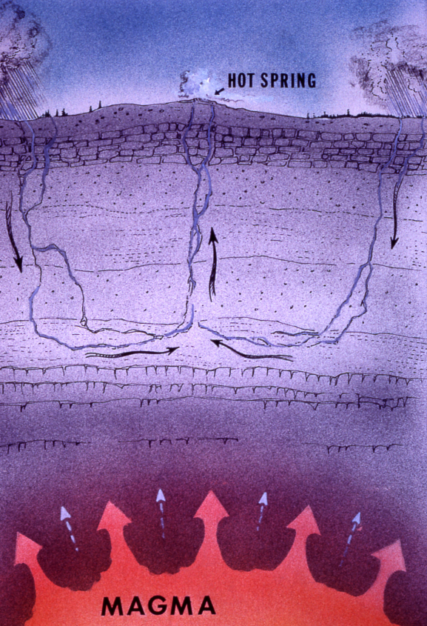
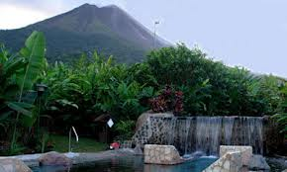
Springs
Hot Springs: Temperatures increase into the earth. Water from hot springs just originate deeper inside the earth or is heated by magma.

Slide 15
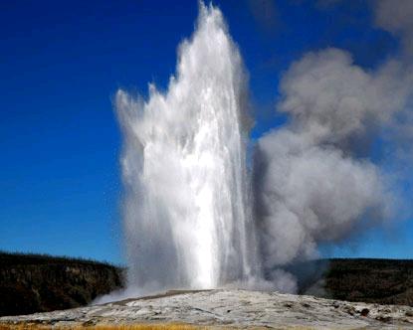
Springs
Geyser: Hot springs that periodically erupt.
Small opening in crust…pressure builds until an eruption occurs
Ex: Old Faithful in Yellowstone National Park

Slide 16
Groundwater Pollution
Ground water is renewable; yet limited
Ways groundwater can be polluted:
Fertilizers
Pesticides
Sewage systems
Industrial chemicals
Arsenic (naturally occurring, factories, mining, and preserving bodies)

