Slide 1
Packet 8 – Biotechnology

Slide 2
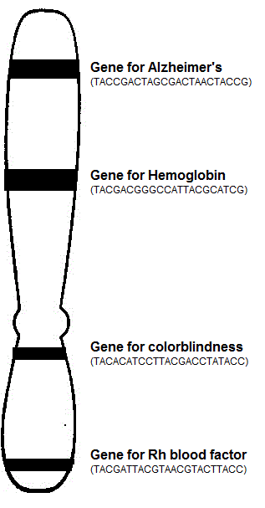
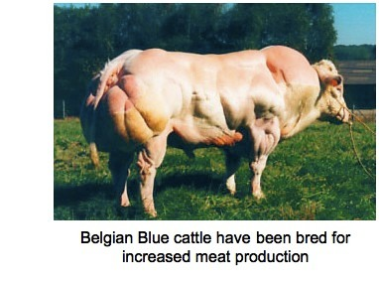
Notes: Introduction to Biotechnology
Terms | Definition | Picture
 | Sequenced all the DNA in a human cell (determined order of A’s, T’s, C’s and G’s) Goal is to identify and treat diseases and disorders.
 | process by which humans breed other animals and plants for particular traits
Human Genome Project
Selective Breeding or Artificial selection

Slide 3
Selective Breeding Example A
Tough wild boars mated with friendly meaty pigs give you robust & meaty pigs for your farm.
Tough Boar + meaty pig = Superpig

Slide 4
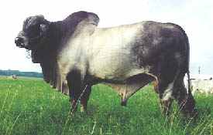
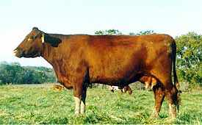
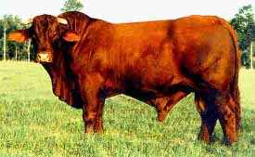
Selective Breeding Example B
Santa Gertrudis cattle
(cross of 2 breeds)
RESULT = good beef and resistant to heat!
Brahman cattle: Good resistance to heat, but poor beef.
English shorthorn cattle: Good beef but poor heat resistance.
hot weather cow + beefy cow = supercow

Slide 5
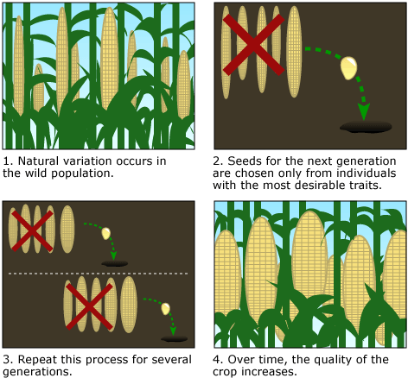
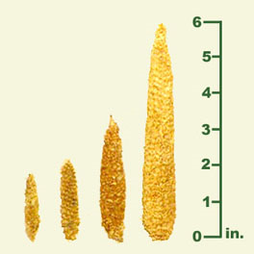
Selective Breeding: Example C
Ancient corn from Peru
(~4000 yrs old)
Choosing only the best corn plants for seeds results in better crops over a long time.

Slide 6
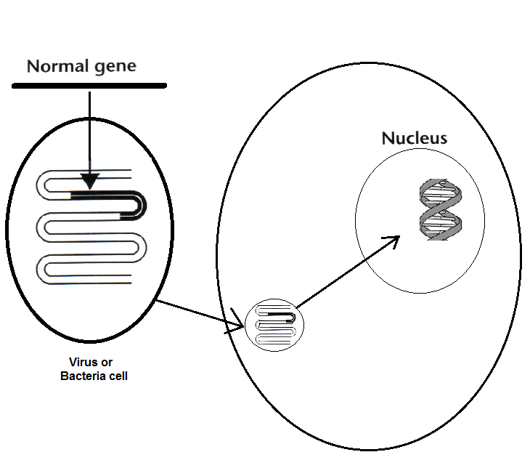
Notes: Introduction to Biotechnology
Terms | Definition | Picture
 | Inserting a working gene into individuals that have a non-working copy of the gene to try and treat or cure a disease
Gene Therapy

Slide 7
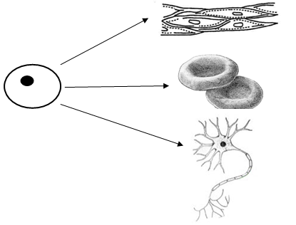
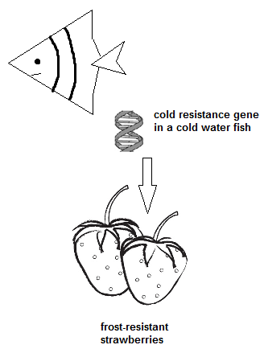
Notes: Introduction to Biotechnology
Terms | Definition | Picture
 | Cells that are not differentiated and can become anything
 | Taking DNA from one organism and putting it into another organism so they exhibit the trait.
Stem Cells
Genetic Transformation

Slide 8
Notes: Introduction to Biotechnology
Terms | Definition | Picture
 | An organism with DNA from another organism.
 | Shows a pattern of DNA that can be used to identify an individual.
Transgenic organism
or
Genetically Modified Organism (GMO)
DNA Fingerprint

Slide 9
Notes: Introduction to Biotechnology
Terms | Definition | Picture
 | Making an identical copy of an organism.
Cloning
So what is biotechnology based on what you learned today?
Using organisms and DNA to produce products, treat diseases and identify people

Slide 10
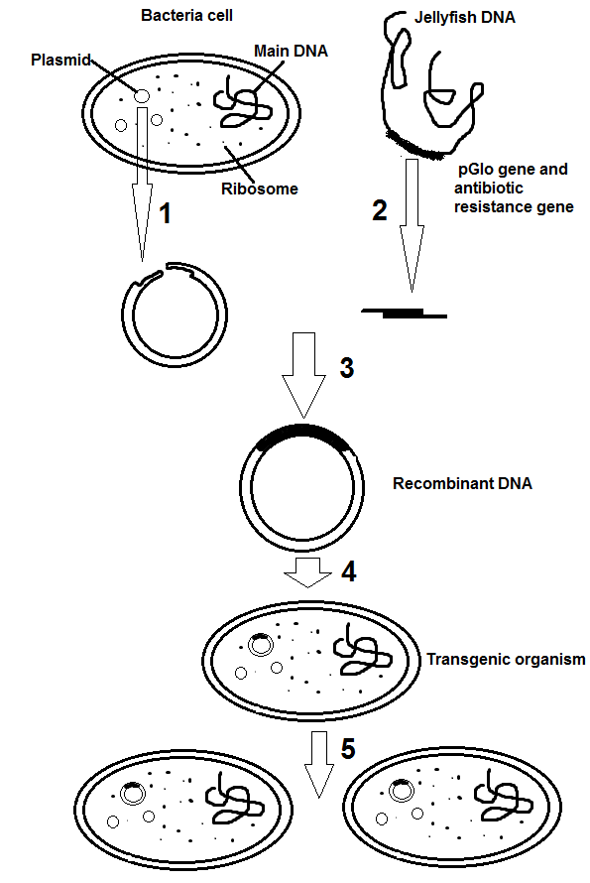
Notes: Genetic Transformation
3
Step # ____: The glowing gene is spliced (placed) into plasmid matching up sticky ends.
Step # ____: Bacteria cell with new gene divides and these cells are able to glow when the gene is turned on.
Step # ____: Plasmid is removed from bacteria cell and is cut with a restriction enzyme.
Step # ____: The glowing gene is cut out of the jellyfish DNA using the same restriction enzyme.
Step # ____: The plasmid is put back into the bacteria cell.
5
1
2
4

Slide 11
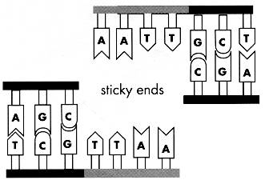
Notes: Genetic Transformation
Why might it be important to use the same enzyme in step 1 and step 2?
This process worked on a bacteria cell, but would it work on a larger organism like a human? Why or why not?
So the plasmid and glow gene have sticky ends that match up. If different enzymes are used then the sticky ends won’t fit together.
Not easily because we have trillions of cells that would have to be changed. Bacteria just have one.

Slide 12
Genetic Transformation Vocab
Word | Definition
Plasmid
Restriction enzyme
Recombinant DNA
Transgenic organism
A small, circular piece of DNA found in bacteria.
Cuts DNA at specific sequences.
DNA from two different sources.
An organism that has genes from another organism inserted into it.

Slide 13
Transgenic Organisms in Agriculture
_______________________________________________ – These plants contain a gene from a cold-water fish that allows it to survive in the colder temperatures. When this gene is inserted into plants they can survive a frost.
_______________________________________________ – Instead of spraying pesticides, plants contain a gene to make their own to avoid being eaten by bugs.
_______________________________________________ – Plants with a gene to help survive with less water.
Frost resistant plants
Pest resistant plants
Drought resistant plants

Slide 14
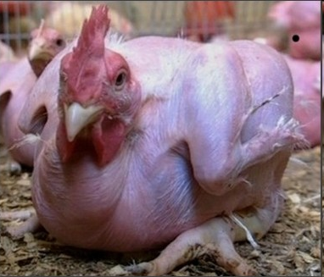
Genetic Engineering Example B:
Make chickens with no feathers.
Scientists engineered chickens to be featherless by REMOVING the gene in chicken DNA that causes them to grow feathers

Slide 15
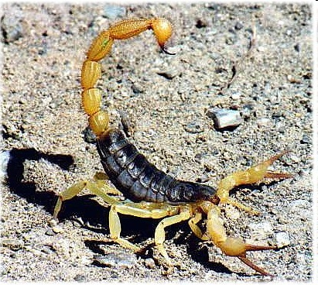
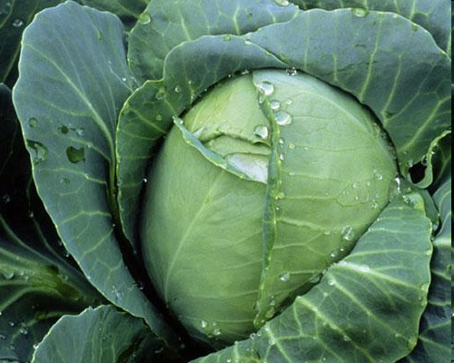
Genetic Engineering Example C:
Cabbage plant +
scorpion venom =
bug-proof veggies
Scientists added a gene for producing scorpion venom to cabbage plants to kill pesky caterpillars that eat crops!

Slide 16
Genetic Engineering Example D:
Give tomatoes the ability to make anti-freeze.
Placing the “anti-freeze gene” from a fish in tomatoes so the tomatoes can still grow in cold weather.

Slide 17
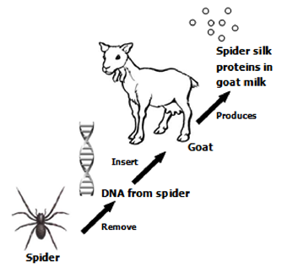
Genetic Engineering to insert specific genes from one organism into another to gain a desired trait.

Slide 18
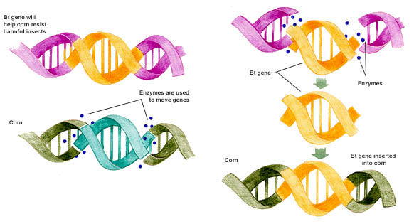
Genetic Engineering of insect- resistant corn
#2 Use restriction enzymes to cut desired gene loose
#1 Identify desired gene
#3 Remove undesired gene
#4 Insert desired gene into corn

Slide 19
Genetic Engineering Example B:
Make chickens with no feathers.
Scientists engineered chickens to be featherless by REMOVING the gene in chicken DNA that causes them to grow feathers

Slide 20
Transgenic Organisms in Industry & Medicine
Bacteria contain genes to digest _____________________.
___________________________________________________ – both of these can be made by taking the gene from a human and inserting it into bacteria. Now the bacteria can make
OIL SPILLS
INSULIN AND HUMAN GROWTH HORMONE

Slide 21
Advantages of Genetic Engineering
Will get improved organisms
Can create organisms with traits not previously thought possible
Can remove“bad” genes
Reduces the chance of getting “undesirable” organisms

Slide 22
Problems with Genetic Transformation
Should we be tampering with genes?
Once genetically modified organisms are out in the environment, they can spread to organisms that have not been modified.
Ethical issues:
Negative environmental impacts (Super C apples & allergies, superweeds, etc.)
The unknowns…
Limitations:
Expensive! $$
Must be done in a lab with specific equipment

Slide 23
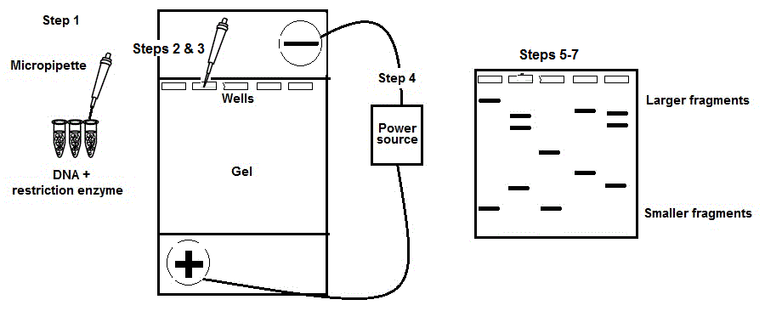
Notes: DNA Fingerprinting

Slide 24
Notes: DNA Fingerprinting
Steps of DNA fingerprinting | Why is each step performed? Think back to the gel electrophoresis lab and paper activity you did.
1. DNA from blood or other tissues is placed into a tube. Restriction enzymes are also added to the tube. Why do we add restriction enzymes to the DNA? Do we add the same or different restriction enzymes to each setup? Why?
2. A gel electrophoresis chamber has been set up. There is a gel that has wells in it at the negative end of the chamber. What are the wells and what do we put in them?
Restriction enzymes cut up DNA.
The same enzyme because the DNA is different and you only change ONE thing in an experiment
The wells are holes that you put DNA into.

Slide 25
Notes: DNA Fingerprinting
Steps of DNA fingerprinting | Why is each step performed? Think back to the gel electrophoresis lab and paper activity you did.
3. Small amounts of DNA are placed inside each of the wells using a micropipette. Each time a new sample is loaded, a new tip is placed on the end of the micropipette. Why is it important to change tips on the micropipette?
4. Once all the wells are loaded, the chamber is then hooked up to an electrical source. Why do we connect the chamber to a power source?
To avoid cross contamination.
Causes DNA to move

Slide 26
Notes: DNA Fingerprinting
Steps of DNA fingerprinting | Why is each step performed? Think back to the gel electrophoresis lab and paper activity you did.
5. The DNA begins to move towards the positive side of the chamber. Why does the DNA move to the positive side of the gel?
6. The DNA separates based on size. How does it separate by size? Explain
The gel is taken out of the chamber and stained. Why do we stain the gels if we are using DNA?
Because DNA is negatively charged and opposites attract.
Smaller fragments move farther. Larger fragments don’t move as far b/c they get stuck.
To see DNA since it is clear.

Slide 27
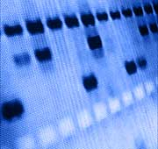
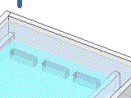
Gel Electrophoresis
The cut DNA is then separated by size in a gel.
Electric makes the DNA move
The smallest pieces travel the furthest through the gel. The largest/longest move the least

Slide 28
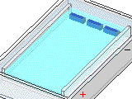
The smallest DNA pieces travel the farthest

Slide 29
Reasons for DNA fingerprinting
There are various reasons why a DNA fingerprint is made including:
Determines who committed a _______________.
_______________________________ - Used to free individuals who have been wrongly accused of a crime.
Determine parents of a child - __________________ (father) and _______________ (mother).
Identify how closely __________________________ organisms are. Organisms that are more closely related have ______________________ DNA bands in common.
CRIME
INNOCENCE PROJECT
PATERNITY
MATERNITY
RELATED
MORE

Slide 30
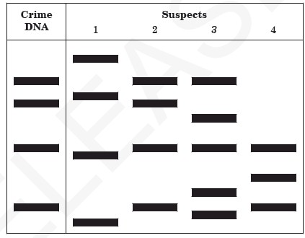
Analyzing a DNA fingerprint
-
Label the positive and negative ends of the gel.
Which suspect has the smallest DNA fragment? _______
Which suspect committed the crime? ________
Suspect 1
Suspect 2
+

Slide 31
3 Types of Stem Cells
____________________________________ – Cells in early embryos, can become any type of cell
___________________________________ - treat diseases of the blood or to restore the blood system after treatment for specific cancers.
___________________________________ - these are tissue-specific, and only form that type of tissue
EMBRYONIC
UMBILICAL
ADULT
ADULT STEM CELL ANIMATION

Slide 32
Notes: Stem Cells
How are scientists trying to use stem cells?
Scientists are trying to develop stem cell _______________________. Since stem cells can become ______________________ types of cells, if a person needs a certain cell type due to injury or disease, then stem cells can be implanted to produce the cells the patient needs.
So what’s the controversy….
Using embryo’s – are we destroying life?
Therapies are still being studied. Some implants have not been successful. Instead of the stem cells developing into the cell the doctors wanted, the stem cells form something else.
Cancer cells
Bone forming instead of nervous tissue in the brain
THERAPIES
DIFFERENT

Slide 33
Notes: Gene Therapy
Gene therapy uses something called a vector to deliver a ____________________ gene taken from a person without the disease and delivering the gene into the cells of the person with the disease.
NORMAL WORKING
VECTOR
_______________________________ – A device used to deliver the gene (“normal” DNA) to the cells of a patient with a non-working copy of the gene. Ex: ___________________ and _______________ because they naturally infect cells.
2 diseases treated this way are:
Severe combined immunodeficiency (­­­­_______ or “bubble boy” disease)
________________________________
VIRUSES
BACTERIA
SCIDS
CYSTIC FIBROSIS

Slide 34
GENE THERAPY - SCID
Severe combined immunodeficiency (SCID or “bubble boy” disease) - is a genetic disorder that impacts the _________________. People with this disease have an immune system that is almost non-existent so these individuals are very vulnerable to infectious diseases.
Treatments include bone marrow transplant and more recently gene therapy. In gene therapy a sample of the patients own ________________________________ are collected and a virus is used to insert the healthy gene into them. These cells that now contain a copy of the correct gene are placed back into the patient’s body. This segment of DNA codes for making the _______________________ the patient needs. Protein synthesis occurs and the patient produces the enzyme that is missing.
IMMUNE SYSTEM
WHITE BLOOD CELLS
ENZYME

Slide 35
GENE THERAPY – CYSTIC FIBROSIS
Cystic fibrosis – In cystic fibrosis patients have an abnormal gene on the 7th chromosome. It affects the _________, pancreas and small intestine. The problem is abnormal __________ build up. For example, in the lungs, water leaves the cells by _____________ and mixes with mucus to keep it from becoming too sticky. Dirt and dust particles in the air that we breathe in are trapped by this mucus layer. The _________ then sweep the dirt and dust particles up and out of the body. With cystic fibrosis, water does not leave the cells by osmosis so the mucus outside the cell gets really thick. The cilia cannot brush this mucus containing the dust particles away and out of the body.
LUNGS
MUCUS
OSMOSIS
CILIA
CASE STUDY – CYSTIC FIBROSIS

Slide 36
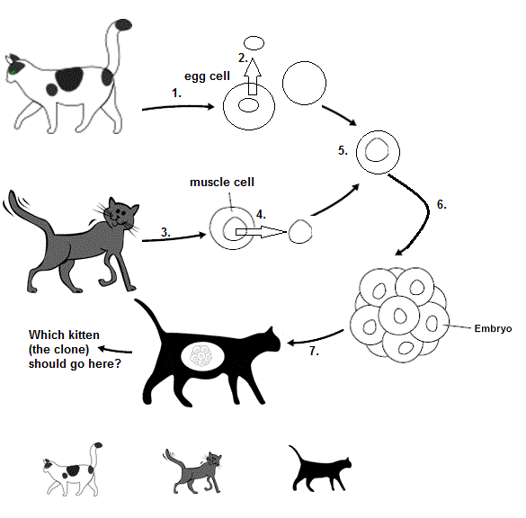
Notes: Cloning

Slide 37
Notes: Cloning
Steps to Cloning: Based on the picture below, write down the steps for cloning a mammal.
_________ Let the egg cell divide to form an embryo.
_________ Place the diploid nucleus into the egg cell. This has the full set of chromosomes.
_________ The cloned animal is born.
_________ Take an egg cell from a female.
_________ Remove the nucleus from the diploid cell.
_________ Place the embryo into a surrogate female.
_________ Remove the haploid nucleus. The nucleus must be removed or there will be too many chromosomes.
_________ Take a diploid cell from an animal.
6
5
8
1
4
7
2
3

