Slide 1
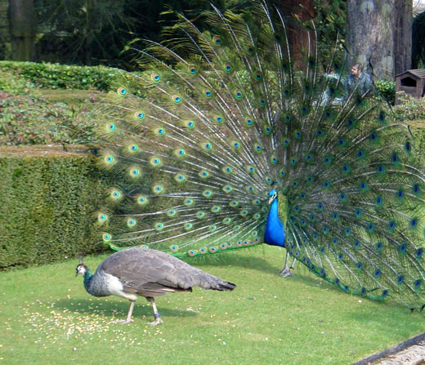
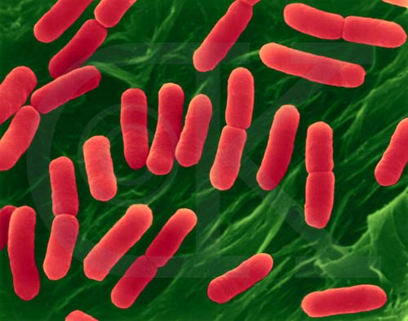
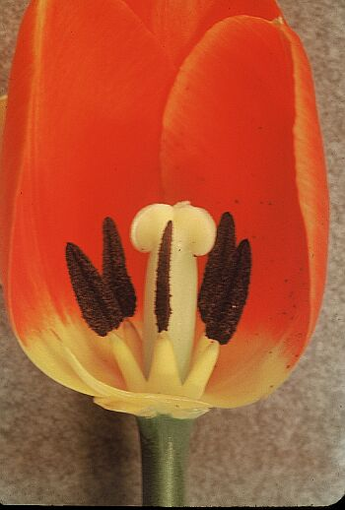
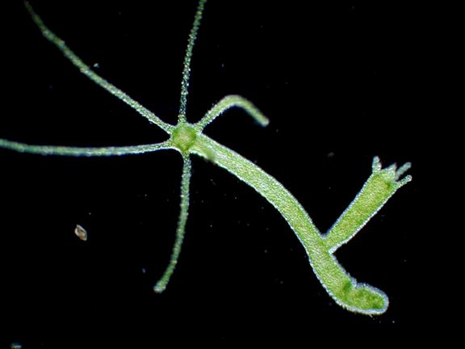
Packet 6 – Cell Reproduction

Slide 2
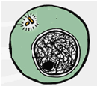
Steps of Cell Division – Asexual Reproduction & Mitosis
Interphase (not a step in mitosis)
DNA looks like chromatin (squiggly).
DNA copies and the cell grows.
Centriole
Nucleus
Chromatin
Centrioles
Spindle fibers
Nucleus
Chromosomes
Prophase (Packs)
Chromatin packs into chromosomes (X’s)
Nucleus breaks down

Slide 3
Steps of Cell Division – Asexual Reproduction & Mitosis
Centrioles
Spindle fibers
Centromere
Chromosomes
Metaphase (Middle)
Chromosomes line up along the middle or equator of the cell
Centrioles
Spindle fibers
Centromere
Chromosomes
Anaphase (Apart)
Sister chromatids move apart towards opposite poles

Slide 4
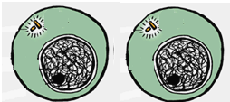
Steps of Cell Division – Asexual Reproduction & Mitosis
Telophase (Two)
Two new nuclei form around the DNA.
Centrioles Nucleus Chromosomes
Chromatin
Cytokinesis (not a step in mitosis)
Cytoplasm divides forming two identical cells.

Slide 5
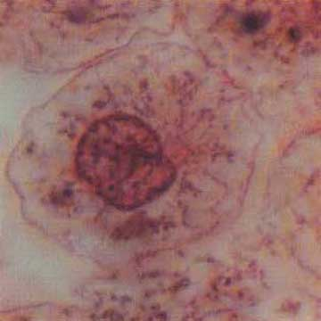
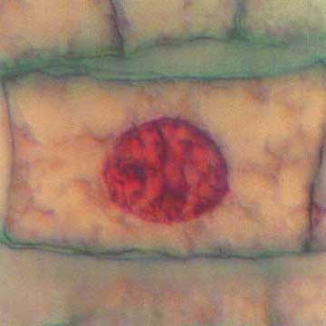
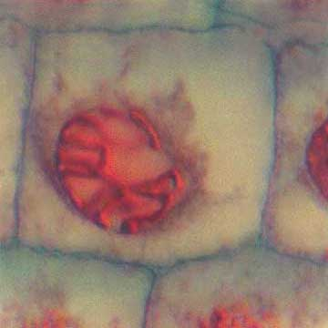
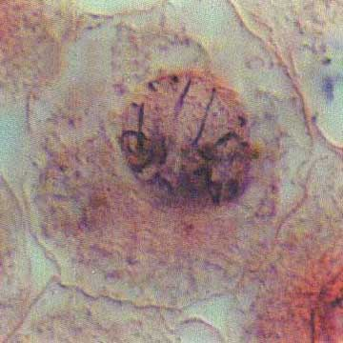
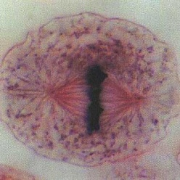
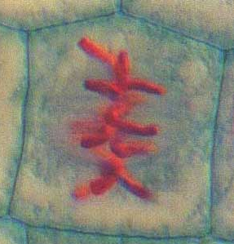
Animal vs. Plant
Interphase
Prophase
Metaphase

Slide 6
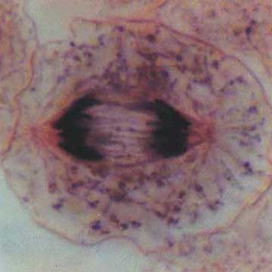
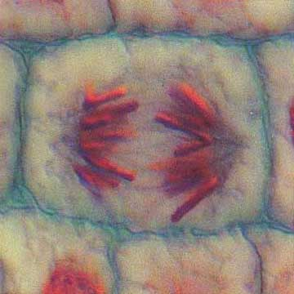
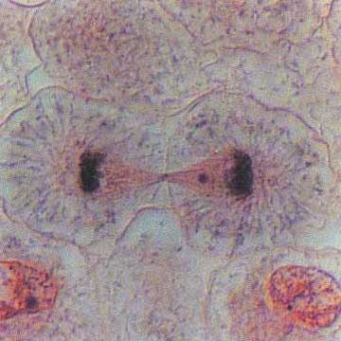
Animal vs. Plant
Anaphase
Telophase/ Cytokinesis

Slide 7
Why do cells reproduce?
Why do cells reproduce?
_____________________ doesn’t work well on a cell that is too big.
Larger cells place too much demand on the genetic info (_________)
To _____________________________________________________
DIFFUSION
1 cm
1 cm
3 cm
1 cm
3 cm
3 cm
DNA
GROW AND HEAL

Slide 8
BACTERIA CELL DIVISION
NO, THEY DON’T HAVE A NUCLEUS
Do bacteria undergo mitosis? ________________________________________
So they copy their DNA and split in two. This is __________________________
BINARY FISSION

Slide 9
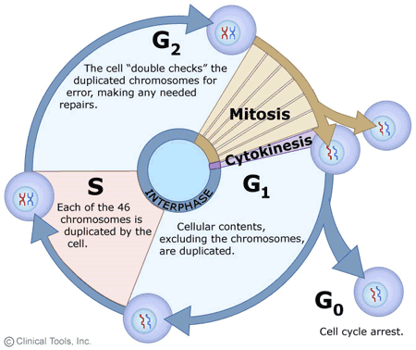
Cell Cycle
http://www.youtube.com/watch?v=I5uFuvkN97I
Video – 6:11
Cell cycle rap – 3:50
Cell cycle rap 2 – 2:19

Slide 10
Cell Cycle Drawing Analysis
What are the 3 main steps of the cell cycle?
What is the longest phase of the cell cycle?
What 2 main things happen during this phase?
After DNA copies what does it look like?
What steps involve the nucleus dividing?
What step involves the cytoplasm dividing?
INTERPHASE, MITOSIS, CYTOKINESIS
INTERPHASE
GROWTH & DNA REPLICATION
An X.
MITOSIS
CYTOKINESIS
Video – 1:03

Slide 11
Control of the Cell Cycle
Cell cycle has key checkpoints to trigger or delay the next phase. The goal of the checkpoints is to make sure the cell is healthy, strong and completing each step correctly. DNA controls these checkpoints. A mutation in the DNA that controls the cell cycle leads to _____________________________. Ultimately the cell cycle continues even when it does not need to and cells keep dividing producing a mass of cells called a ________________________.
CANCER
TUMOR
Cancer video 1 – 1:07
Cancer video 2 – 1:43
Cancer video 3 – 11:00 – watch only first half

Slide 12
Difference between chromatin, chromosomes and chormatides
To move easier
Identical

Slide 13
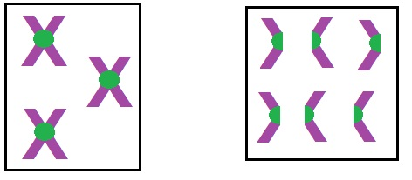
How do you count chromosomes?
When asked the particular number of chromosomes in a cell, always count ________________!!!!!
CENTROMERES
3 chromosomes and 6 sister chromatids
6 chromosomes

Slide 14
Goal of Mitosis vs. Meiosis
The goal of mitosis is to create _____________ cells with the __________ number of chromosomes to help with growth and healing.
The goal of meiosis is to create the _______ cells with _____the number of chromosomes.
BODY (SOMATIC)
SAME
GAMETES OR SEX
HALF

Slide 15
Mitosis vs. Meiosis

Slide 16
Cell Differentiation
You start out as one cell. Before that cell divides by ____________________it makes an ____________________ copy of DNA. During __________________________, only specific parts of the DNA are ______________________; and this determines the type of cell. Once a cell differentiates, this cannot be ______________________.
MITOSIS
IDENTICAL
DIFFERENTIATION
“TURNED ON”
REVERSED
Cell Differentiation in a Chicken Video

Slide 17
Stem cells to Differentiated cells

Slide 18
Advantages of Sexual Reproduction
An advantage of meiosis coupled with sexual reproduction is the genetic diversity that is the result of:
of an egg and sperm.
(random organization of chromosome pairs at the equator).
occurs during meiosis I in which homologous chromosomes exchange pieces of chromosomes.
RANDOM FERTILIZATION
INDEPENDENT ASSORTMENT
CROSSING OVER

Slide 19
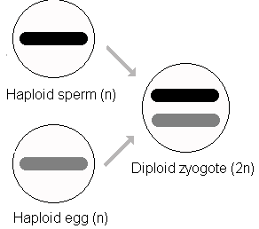
Haploid vs. Diploid Cells
HAPLOID
Meiosis makes the sex cells which are ________________ (have half number of chromosomes).
During _____________ the egg and sperm join to form a _____________________ cell with both chromosomes again.
How many pairs of chromosomes does a human have?
FERTILIZATION
DIPLOID ZYGOTE
46

Slide 20
Mitosis vs. Meiosis Table
Animation Comparing Both Processes
 | Description | Mitosis | Meiosis
1 | In what cells do these processes occur?
2 | Involved in Sexual or Asexual Reproduction?
3 | How many times does the nucleus divide?
4 | At the end of the process, how does the daughter cell compare to the parent?
5 | Diploid or Haploid at the beginning of the process.
6 | Diploid or Haploid at the end of the process.
SOMATIC
GAMETES
ASEXUAL
SEXUAL
1
2
HALF CHROMO. #
IDENTICAL
DIPLOID
DIPLOID
DIPLOID
HAPLOID

Slide 21
Mitosis vs. Meiosis Table
 | Description | Mitosis | Meiosis
7 | Does the process increases genetic variation?
8 | How many cells are produced at the end?
9 | Describe a human cell that would be produced by each process (include information about the chromosome number)
10 | Advantages
11 | Disadvantages
NO
YES
2
4
SKIN CELL – 46 CHROMO.
SEX CELLS – 23 CHROMO.
GENETIC DIVERSITY
FAST, EASY
NO DIVERSITY
TAKES MORE TIME AND ENERGY

Slide 22
Chromosomal Mutations
piece of a chromosome breaks off Ex: Cri du Chat syndrome (“cry of the cat”) infants have a distinctive cry, severe mental retardation and short life span.
crossing over between homologous chromo. doesn’t happen evenly Ex: Certain types of cancer
DELETION
DUPLICATION DELETION

Slide 23
Chromosomal Mutations
INVERSION
Genes on chromosome are flip floppedEx: Hemophilia (blood clotting disorder)
chromosome piece attaches itself to a nonhomologous chromosome Ex: Leukemia
TRANSLOCATION

Slide 24
Karyotype 1
Karyotype 1 – Normal
Humans have ________ total chromosomes. _____ come from mom and the other ______ come from dad.
Paired chromosomes are __________ chromosomes since they are similar to one another. Two #1’s are homologous. #1 is non-homologous to number 6.
_______________________ - 1st 22 pairs of chromosomes (44 total)
_______________________ - 23rd pair (2 total) determines your _______
Female (2 big) _____ Male (big and little) _____
46
23
23
HOMOLOGOUS
AUTOSOMES
SEX CHROMOSOMES
SEX
XX
XY

Slide 25
Karyotype 2
Karyotype 2:
Is this person male or female? How do you know?
Circle the mistake in the karyotype. This is _________________________
This is the result of a _______________. This occurs when the chromosomes don’t separate during meiosis so one parent gives 2 chromosomes instead of just 1. This is also called a ________________.
Female – XX (2 BIG)
Down’s syndrome.
NONDISJUNCTION
TRISOMY 21

