Slide 1
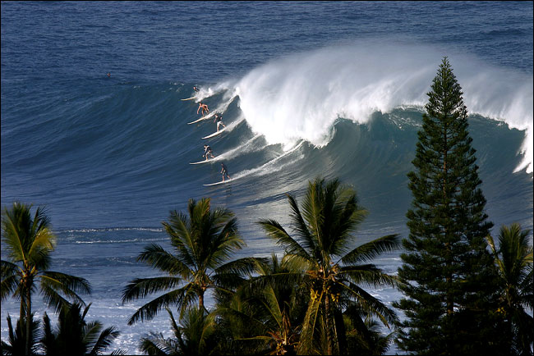
Waves and the Shore

Slide 2
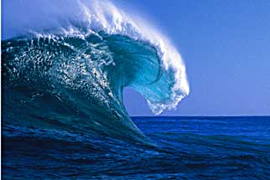
Waves
Waves are ocean energy traveling along the boundary between the ocean and the atmosphere.
The power of the waves is most noticeable near the shore.

Slide 4
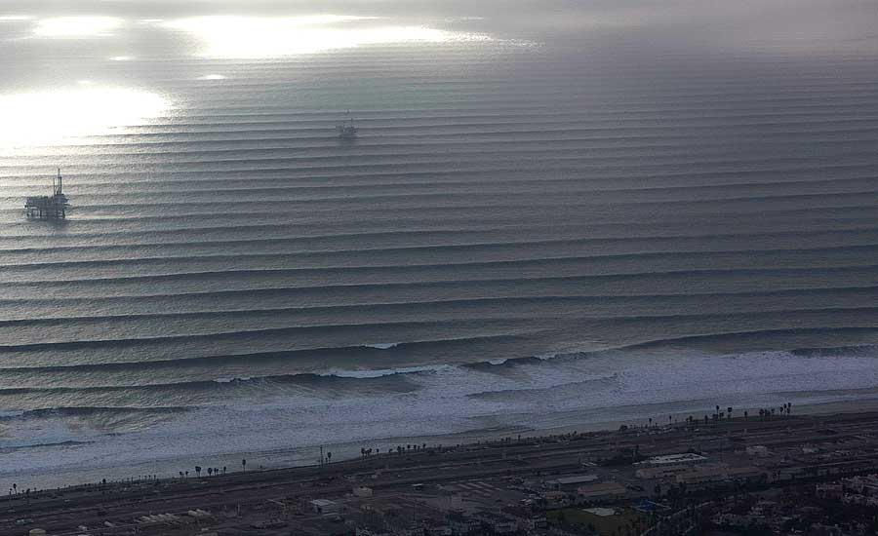
One of a group of long rolling waves is a swell.
Three things that effect the size of a wave:
The speed of the wind.
The length of time the wind blows.
Fetch – the distance the wind blows

Slide 5
Crest: High point of the wave
Trough: Low point between
two crests
Wave Height (vertical): distance between the crest and trough (levels)
Wave Length: Distance between two corresponding points (either crest to crest or trough to trough.) The average W.L. is 2-3 times the wave’s height.

Slide 6
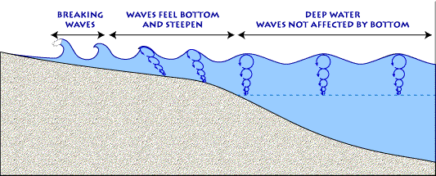
Waves break in water that is as deep as one half the wavelength.
Energy in a wave- As a wave moves across the surface of the ocean, only the energy moves forward…not the water!

Slide 7
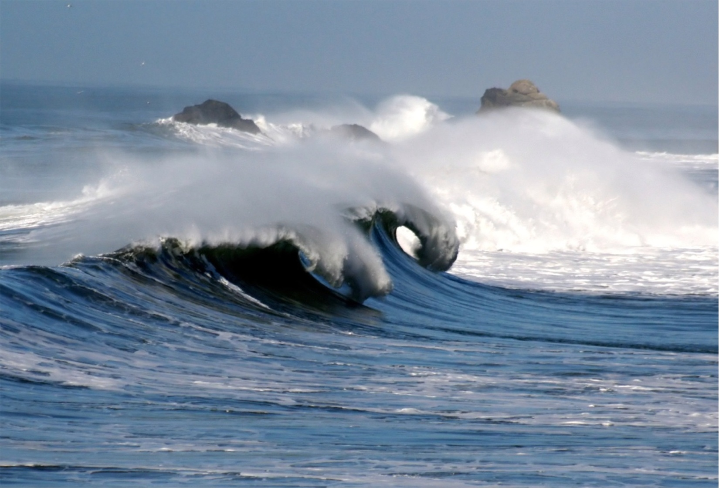
Breakers – the foamy mass of water that washes onto the shore.
If the ocean floor is steep, the wave breaks with great force.
If the ocean floor is not steep, the wave spills forward with a rolling motion.

Slide 8
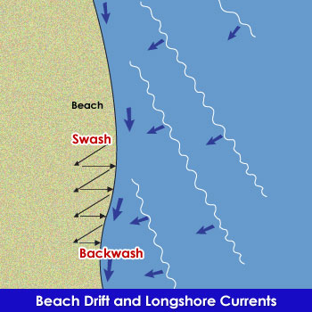
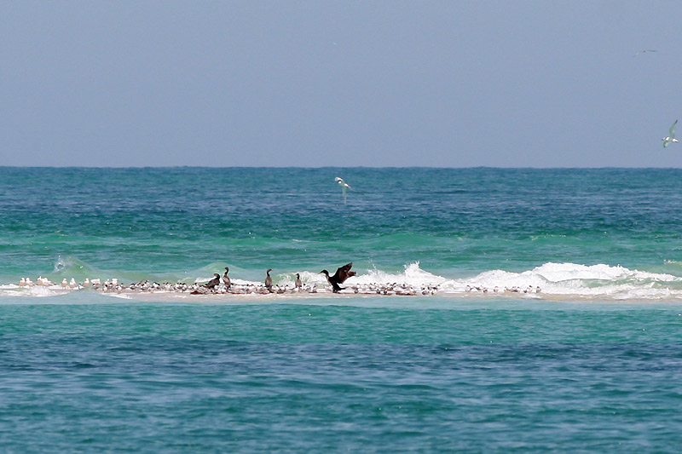
Longshore currents - movement of water that parallels the shore within the surf zone.
Occurs when waves approach the beach at an angle
Form long sandbars.

Slide 9
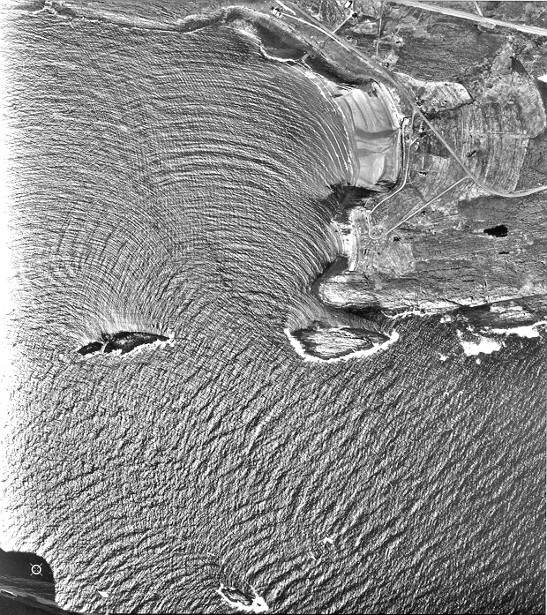
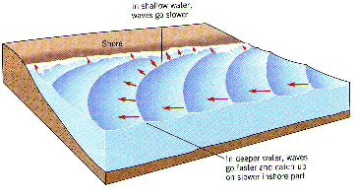
Refraction
Waves approach the shore at an angle. They bend when they reach shallow water. This is called refraction.
Refraction causes waves to hit the shore head on.

Slide 10
Undertow: generally a gentle current that moves water and sand from the beach back to the shore.
Rip Current: a dangerous current that flows away from the beach carrying sand and water.
How can a swimmer escape a rip current?
Swim parallel to shore and come back toward land on a wave.

Slide 11
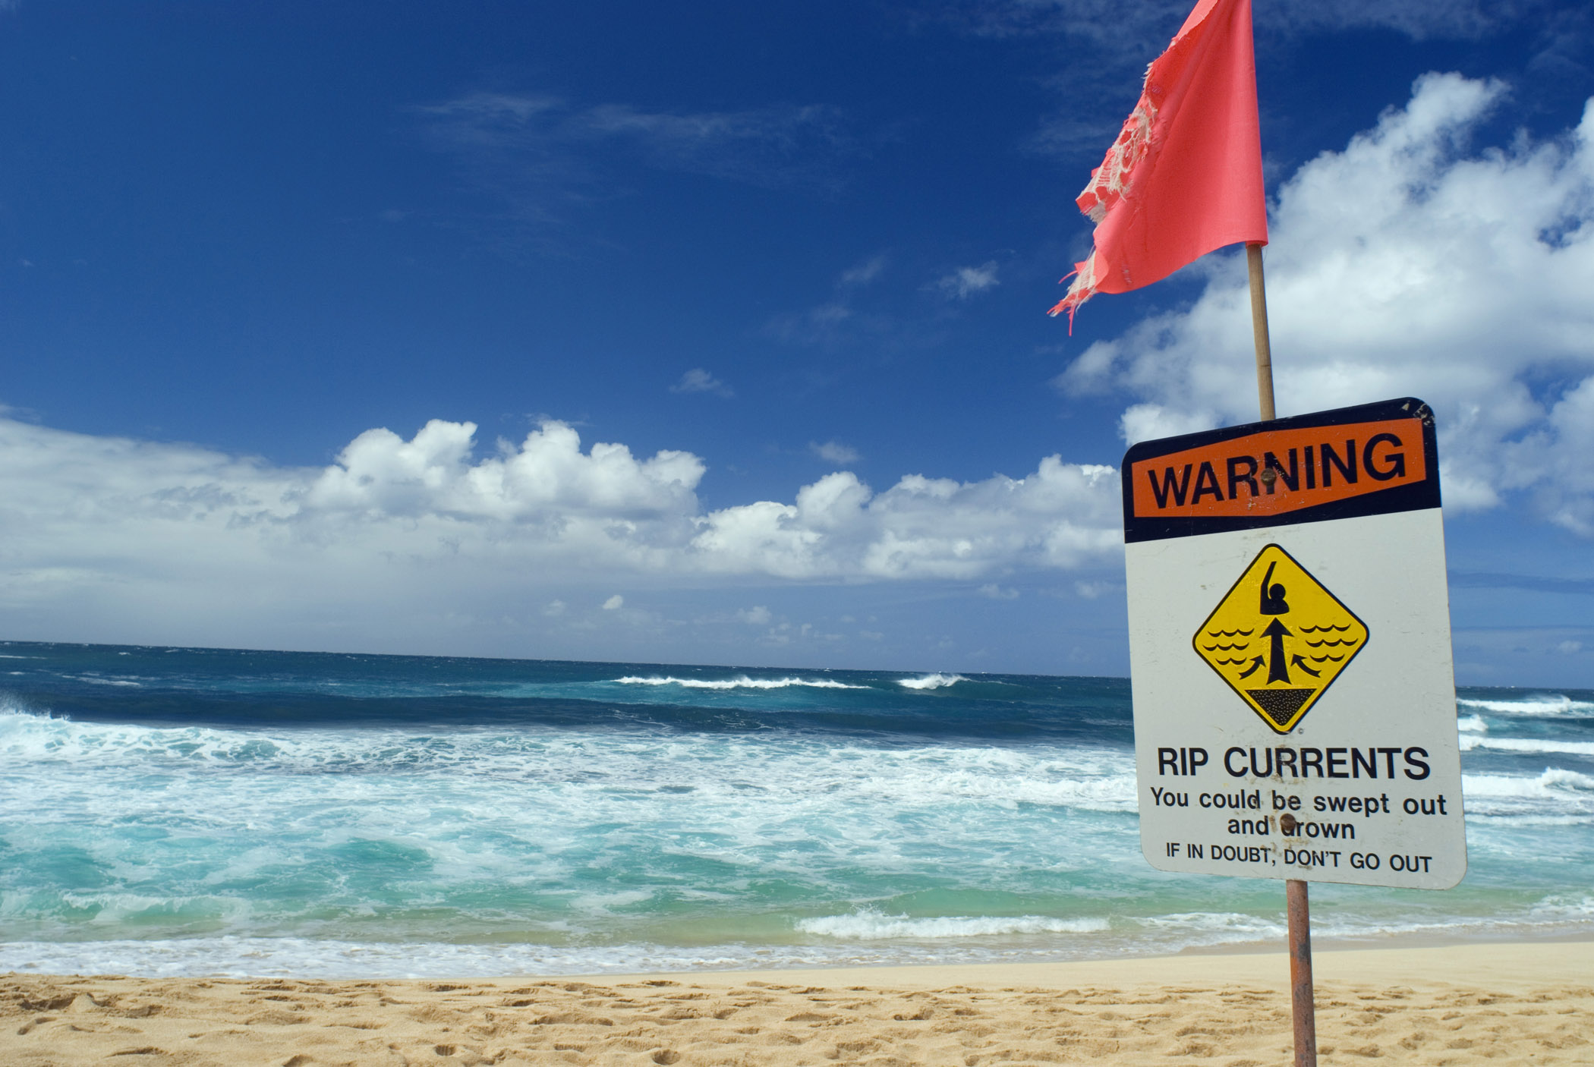
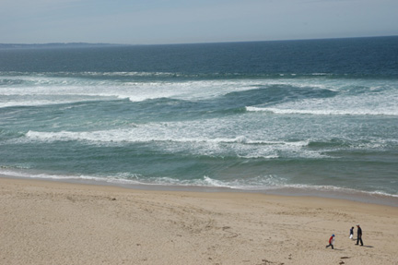
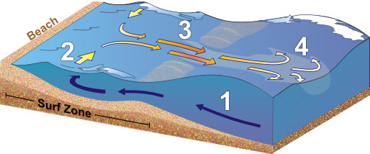
Rip currents form when water from large breakers returns to the ocean through channels in underwater sandbars.

Slide 12
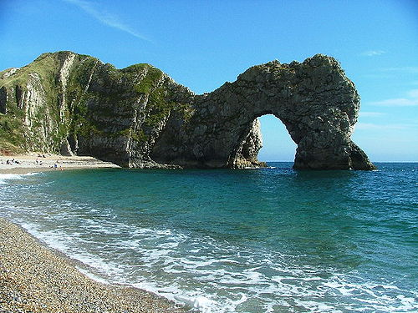
Wave Erosion
Waves along the shoreline are constantly weathering, eroding and depositing sediment. Many shoreline features can result from this activity.

Slide 13
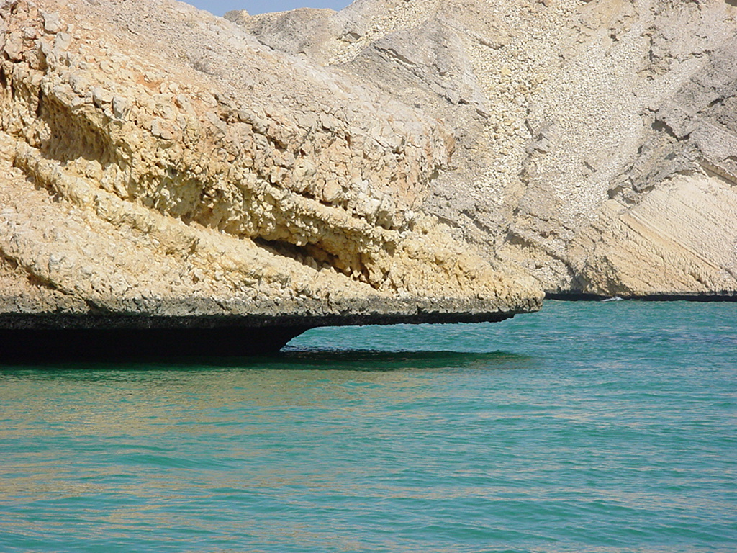
Wave-cut cliffs and platforms
Result from the cutting action of the surf against the base of coastal land.

Slide 14
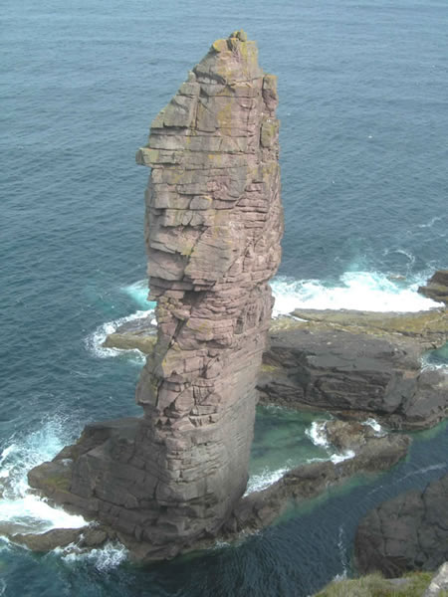
Sea arches and Sea stacks
Headlands that extend into the sea, and are attacked on all sides because of refraction, are eroded in the center;
First forming arches and then, when the arch caves in, forming a sea stack

Slide 15
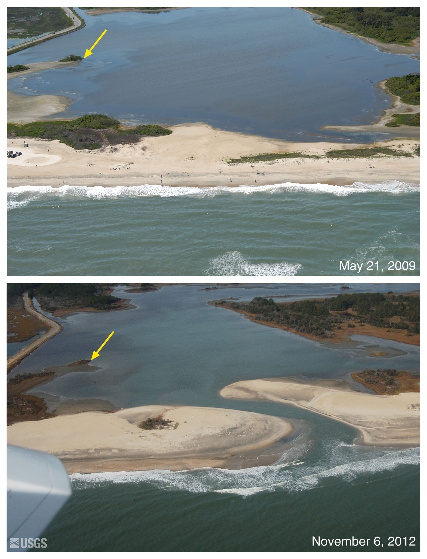
Depositional Features
Sediment that is transported along the shore and deposited in low energy areas form these features.

Slide 16
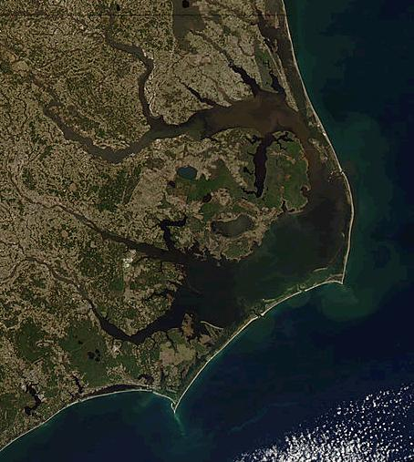
Barrier islands – a string of islands that run parallel to a coastline.
They are leftover after a rise in sea level over time…
Or leftover sandbars after a drop in sea level

Slide 17
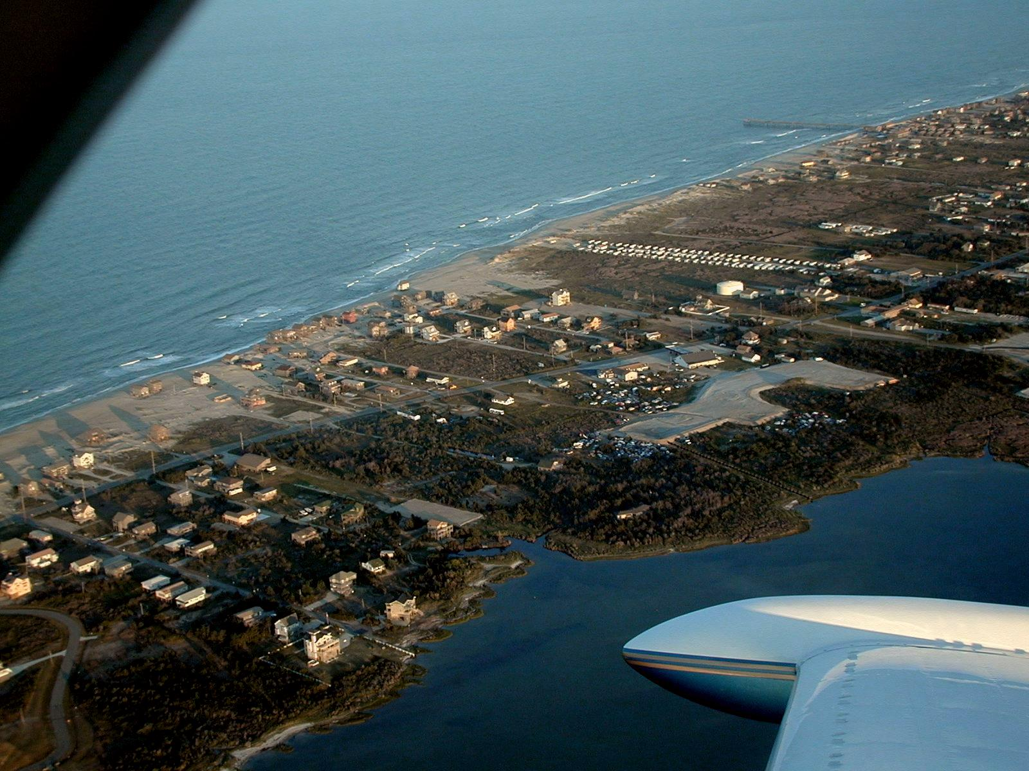

Slide 18
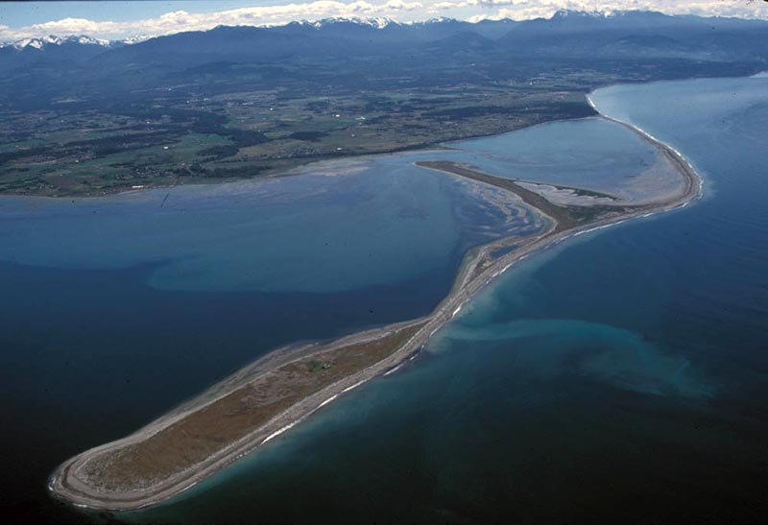
Spits – sandbars that are connected to land.

Slide 19
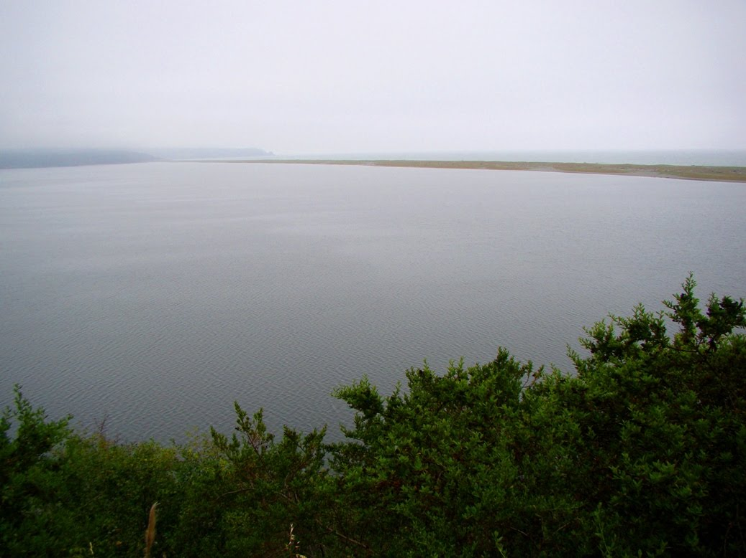
Bars– a sandbar that spans an entire bay or inlet.

Slide 20
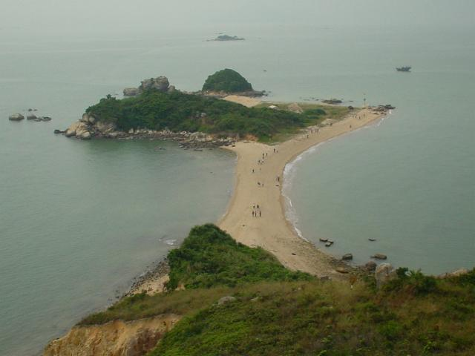
Tombolo – a ridge of sand that connects an island to the mainland.

Slide 21
Shoreline Stabilization
Groins, breakwaters, seawalls, and beach nourishment are designed to prevent or slow down shoreline erosion
Groins, breakwaters, and seawalls require construction while beach nourishment does not
Only offer temporary solutions to shoreline problems.

Slide 22
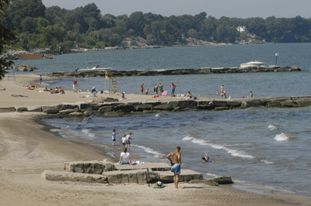
Groins (Groynes)

Slide 23
Breakwaters

Slide 24
Seawalls

Slide 25
Beach nourishment
Sediment lost through erosion is replaced from sources outside of the eroding beach
Most sand comes from offshore.
Expensive
Short term solution

Slide 26
