Slide 1
Soil Conservation

Slide 2
Soil Erosion
Soil erosion is a big problem for the agriculture industry and is affected by the following factors:
Climate
Slope Steepness
Type of Vegetation
Soil Conservation combats this erosion

Slide 3
Methods of Soil Conservation
Terracing: Step like ridges are built and arranged sideways on a hill. Slows down water erosion.
Contour plowing: Cultivated rows run sideways, rather than up and down. Slows down water erosion.

Slide 4
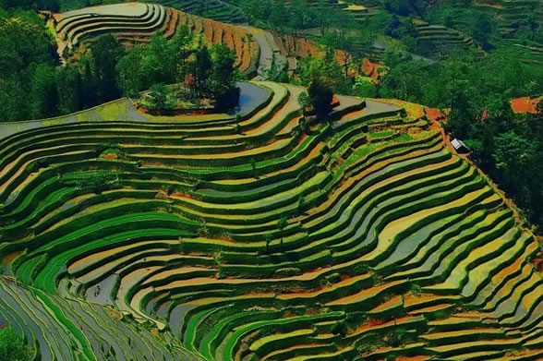
Notes:
http://purpleopurple.com/why-when-how-where-what/why-terracing-is-helpful-for-farmers.jpg

Slide 5
Methods of Soil Conservation
Strip cropping: Different crops are grown on the same piece of land and rotated the next year. Catches soil eroded from other crop.
Shelter belt: Rows of trees are planted close together to help force wind movement upward, away from the ground.

Slide 6
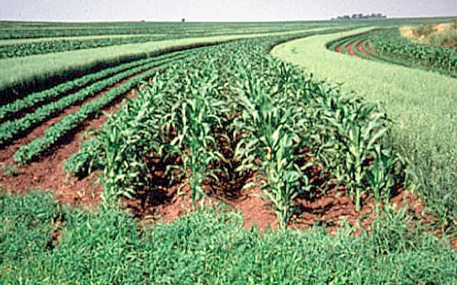
Notes:
http://www.takdangaralin.com/wp-content/uploads/2009/08/StripCropping.jpg?9d7bd4

Slide 7
Traditional vs. Sustainable Agriculture

Slide 8
Traditional Agriculture Techniques
Slash and Burn
the cutting and burning of plants in forests or woodlands to create fields
Clear Cutting
most or all trees in an area are uniformly cut down
Tillage
Preparing a field by digging, stirring, or overturning soil
Monoculture
growing a single crop or plant species over a wide area and for many consecutive years
Fertilizer
Pesticide/ Herbicide/ Insecticide

Slide 9
Sustainable Agriculture Techniques
Crop Rotation
Growing different crops in succession in the same field
Replenish soil nutrients
Cover Crops
Prevent soil erosion
Suppress weeds
Soil Enrichment
Adding a layer of manure, mulch, or compost
Integrated Pest Management
Solve pest problems while minimizing risks to people and the environment

Slide 10
Sustainable Techniques Terms on Environmental Quality
Magnitude - the size, extent, or importance of a technique
Duration - the length of time a technique continues
Frequency - number of occurrences of a technique

Slide 11
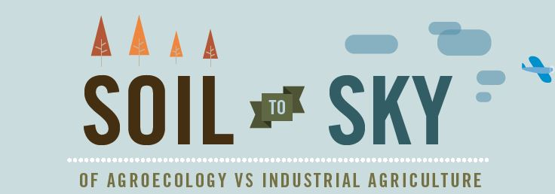
Agroecology vs. Industrial
Agriculture
click here

