Slide 1
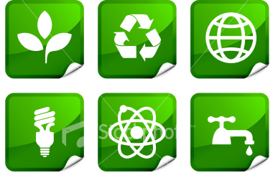
Alternative Energy
Alternate energy sources are safe and most are renewable.
Notes:
http://duelingfuels.com/wp-content/uploads/2010/05/ist2_5490264-final-alternative-energy-sticker-set1.jpg

Slide 2
7 types of Alternative Energy:
Solar
Nuclear
Wind
Hydroelectric
Geothermal
Tidal
Biomass
Notes:
http://3.bp.blogspot.com/_WvXS7GKZ0iM/SRyBZjYKZ8I/AAAAAAAAAt0/_YNlNSxt3gE/s400/renewable%2B_energy.gif

Slide 3
Solar energy harnesses the power of the sun.
Advantages: free, unlimited supply, non-polluting.
Disadvantages: Equipment can be expensive, supplemental heating unit needed when sun is not out (backup).
Practical for NC?
Notes:
http://www.crazywebsite.com/Pg-Free-Clipart-Graphics/Images_Celebrate_Labor_Day_Weekend_Clipart_Photos/Animation_Sun_Summer_Funny_Smile-1sm.gif

Slide 4
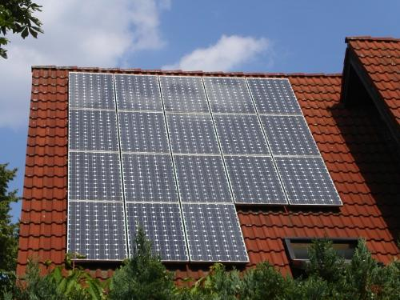
Solar Energy
1. Active Solar – Collect Solar Heat
2. Passive Solar – Southern Facing Windows
3. Photovoltaic Cells – Cells convert light into electricity
4. Mirrors – Focus light onto water tanks to create steam

Slide 5
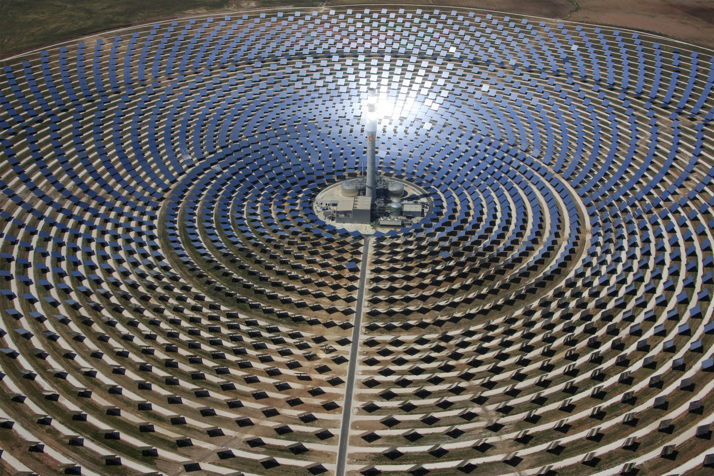

Slide 6
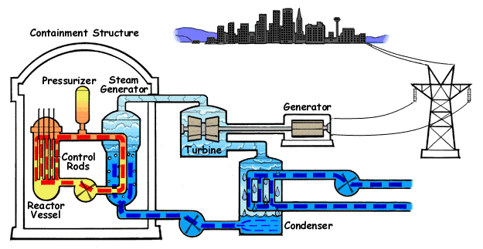
Nuclear Energy
Creation of Energy from Fission
What is fission? (Fusion?)
Advantages: produces a lot of energy from little material
Disadvantages: Dangerous waste, potential meltdown.
Practical for NC?

Slide 7
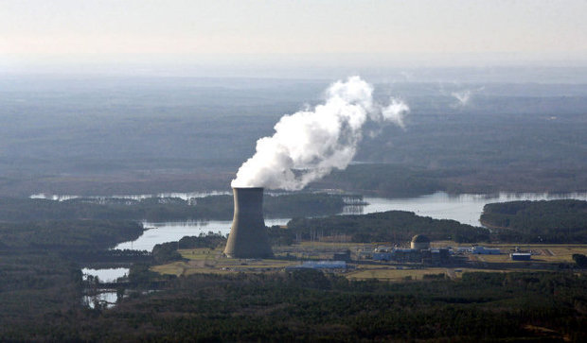
Shearon Harris

Slide 8
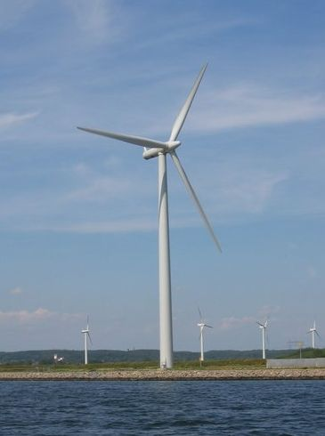
Wind Energy
Generating electricity by using wind to turn turbines.
Current US: 4.35% of all electricity
Advantages: Cheap, safe
Disadvantages: Unpredictable. Disrupts TV and radio reception
Practical for NC?

Slide 9
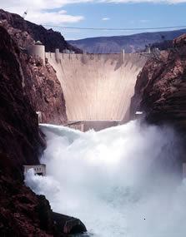
Hydroelectric Power
Power generated by falling water and turbines. Water is stored behind a dam which channels it through turbines to generate electricity.
Advantages: free, safe, renewable.
Disadvantages: sediment buildup behind dams, droughts, lack of suitable locations (most built in mountainous areas).
Practical for NC?
To See Hydroelectric Dam Animation click Here!

Slide 10
Hoover Dam

Slide 11
Geothermal Energy
Harnesses by tapping natural underground reservoirs of steam and hot water. The hot water is used directly for heating and to turn turbines to generate electricity.
Advantages: safe, clean
Disadvantages: limited locations, can deplete groundwater
Practical for NC?

Slide 13
Tidal Power
Harnesses the energy of the ocean by constructing a dam across the mouth of the bay or estuary. The strong in and out flow that results drives turbines and electric generators.
Advantages: safe, inexpensive and renewable
Disadvantages: locations ideal in coastal areas with a tidal range more than 8 m.
Practical for NC?
Notes:
http://www.amazing-animations.com/animations/wave2.gif

Slide 15
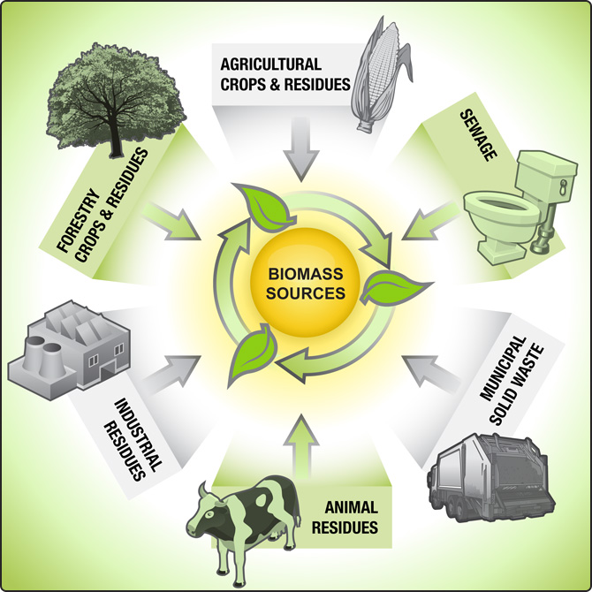
Biomass
Obtaining energy by burning fuels from living or recently living organisms.
Advantages: takes carbon out of the atmosphere as it is growing and returns it as it burns—no net increase in CO₂
Disadvantages: inefficient, increases methane, needs more land
Practical for NC?

Slide 16
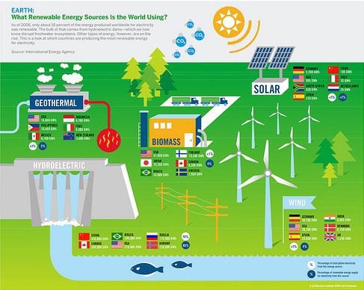
Alternative Energy

