Slide 1
Earth Chemistry

Slide 2
Matter
Anything that has mass and volume.
Solid: definite shape; definite volume
Liquid: no definite shape; definite volume
Gas: no definite shape; no definite volume
Plasma: is a gas in which a certain portion of the particles are ionized; no definite shape or volume;

Slide 3
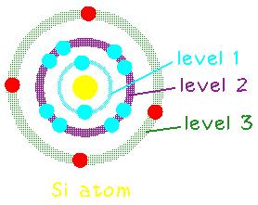
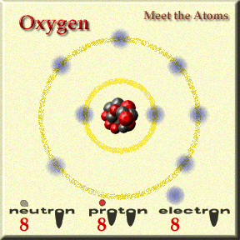
Element
Substance that cannot be broken down into simpler substances.
Ex. Oxygen, hydrogen, chlorine
115 known elements; 92 occur naturally.

Slide 4
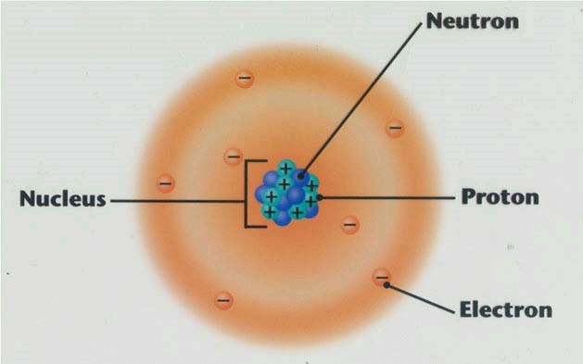
Atom
Smallest part of an element that has all the properties of that element.
Subatomic particles are the parts of an atom.
Electrons: negatively charge
Protons: positively charged
Neutrons: neutral (no) charge

Slide 5
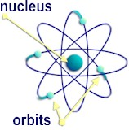
Structure
Nucleus: protons + neutrons
positive charge
Electron cloud: energy levels inhabited by electrons
overall negative charge.

Slide 6
Fusion vs. Fission
Fusion
Fission
Combines atoms
Larger atoms are formed
Fuse hydrogen atoms into helium atoms
In the core of the sun
Higher temperatures are created
Splits atoms
Smaller atoms are formed
Use uranium atoms to begin reaction
Nuclear power plants
Creates radioactive waste
What do we do with it?
BOTH:
Release energy
Use atoms
E = mC²

Slide 7
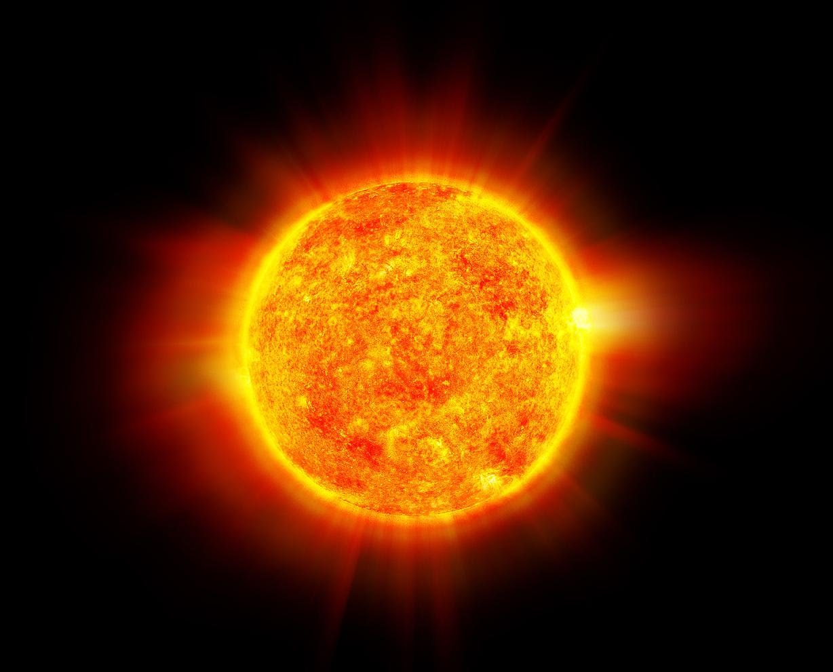
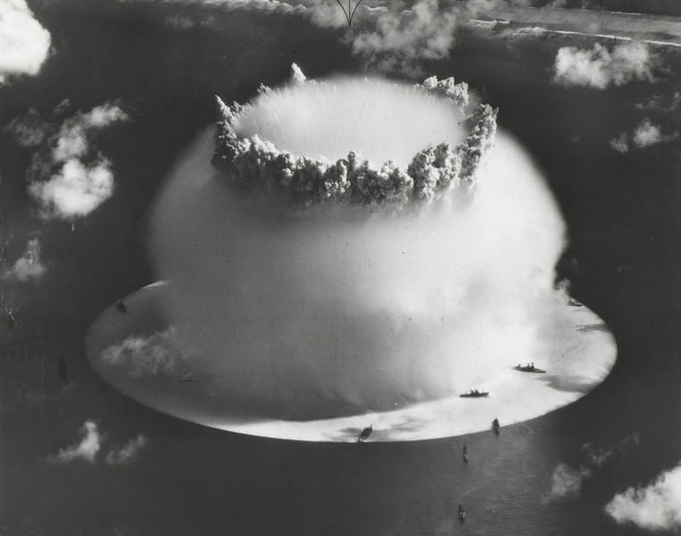
Fusion
Fission

Slide 8
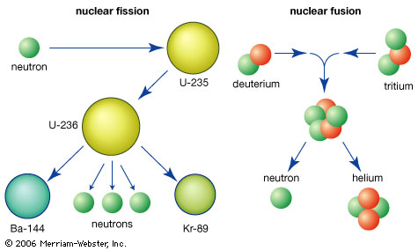

Slide 9
Our Sun
Made up entirely of plasma
Gas that shares electrons
Average rotation: 27 Earth days
Surface temperature = 5500ºC (9932ºF)
Interior temperature = 15,000,000ºC (27,000,000ºF)
FUSION TAKES PLACE!!!!!!!!!!!!!!
http://www.youtube.com/watch?v=OlKfpaSOuBM&feature=related

Slide 10
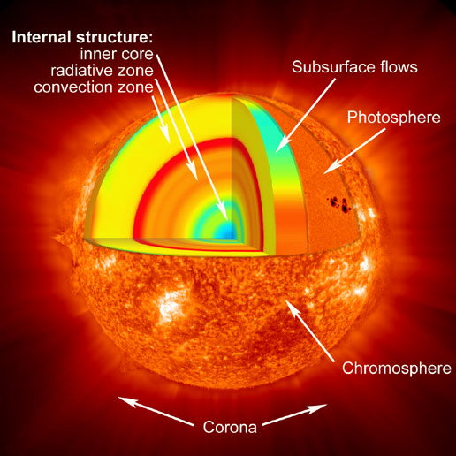

Slide 11
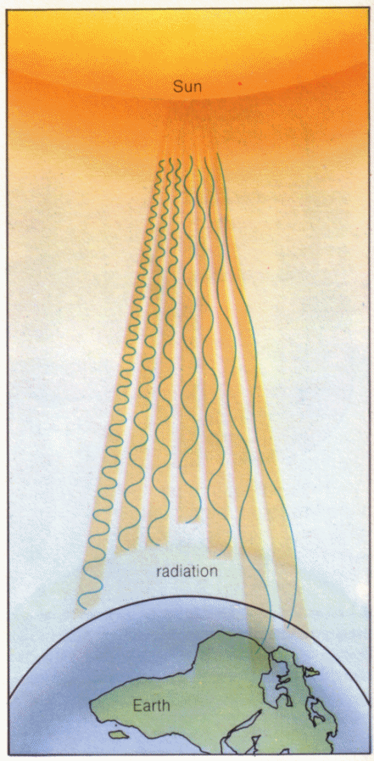
Sunlight
The sun radiates energy into space
This energy is called electromagnetic energy and travels to Earth in the form of radiation
Speed of light: 3x10^8 m/sec
The term “radiation” simply means that the energy travels as rays, in straight lines

Slide 12
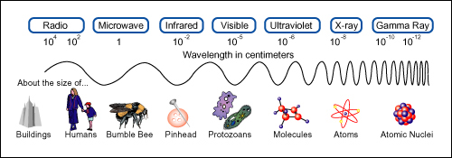
Electromagnetic Spectrum
There are many different types of electromagnetic energy
Differentiated by wavelength and frequency
All together we called them the electromagnetic spectrum
The sun mostly emits ultraviolet, visible light, and infrared

Slide 13
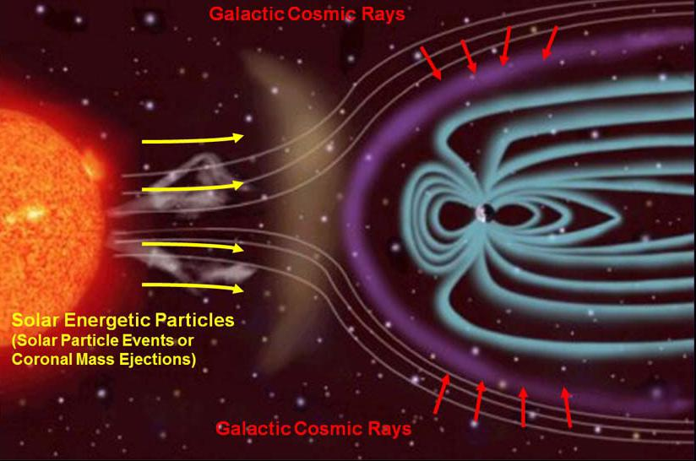
Cosmic Rays
High-energy particles that flow into our solar system
Most deflected by Earth’s magnetic field
Others interact with Earth’s atmosphere and collide with molecules in the air

Slide 14
Solar Energy for Life on Earth
Life on Earth relies on solar energy from the sun!
Plants transform solar energy into chemical energy through photosynthesis
Make food for themselves
We eat the plants or eat the animals that eat the plants!

