Slide 1
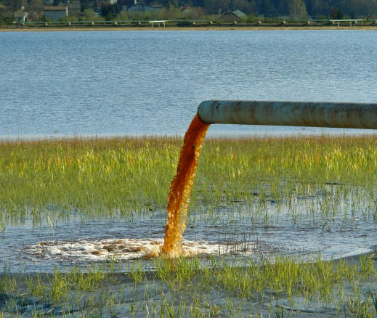
What is water pollution?
Water pollution is the addition of harmful chemicals to natural water.

Slide 2
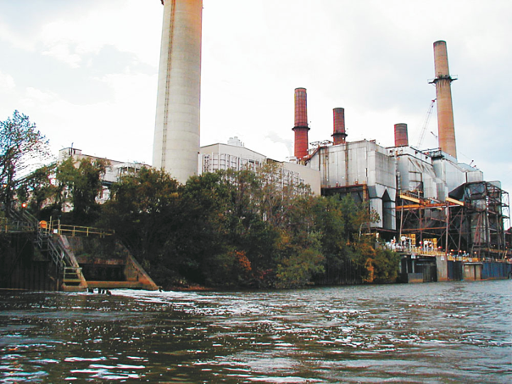
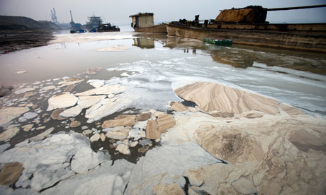
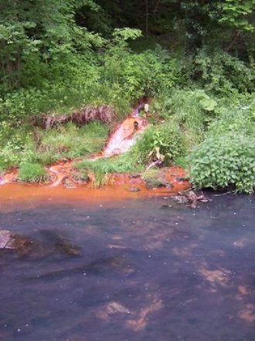
What are some sources of water pollution?
Sources of water pollution in the US include
industrial waste
run-off from fields treated with chemical fertilizers
run-off from areas that have been mined

Slide 3
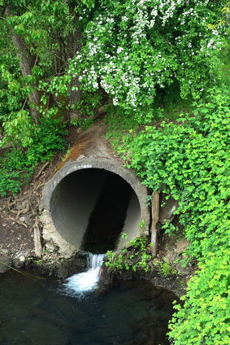
What is point source pollution?
Point Source Pollution - contamination that enters the environment through a specific traceable means
Ex. Sewage plant pipe, Coal ash ponds

Slide 4
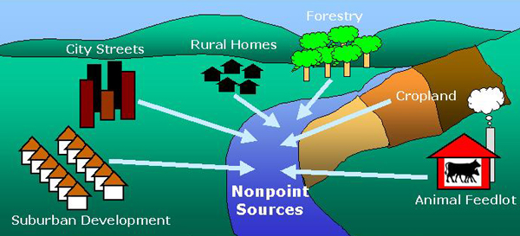
What is non-point source pollution?
Non-Point Source Pollution - does not have a specific point of origin.
Results from land runoff, precipitation, atmospheric deposition, drainage or seepage.

Slide 5
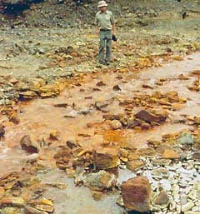
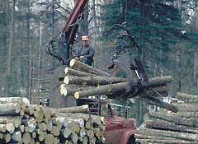
Non-point source examples
Stormwater runoff
Arsenic from mining
Sediment from land runoff
Runoff – any water that does not infiltrate into the ground

Slide 6
How to reduce Point and Non Point Pollution
Use fertilizer and pesticide according to package directions
Have septic systems inspected every 2-3 years.
Conserve sprinkler water
Never dump anything down a storm drain.
Pick up after your pets. Pet waste left on the ground can spread E. coli, roundworms and Salmonella.
Notes:
Extra nutrients can runoff your lawn and into our water supply, leading to unhealthy algal blooms.

Slide 7
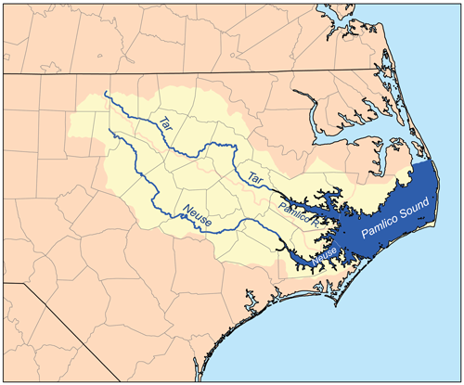
How do pollutants move through the water supply?
Pollutants move through a water supply along with the water!
As water moves towards the ocean, pollutants build up and can become more concentrated.

Slide 8
Population Effects on Water Quantity
Communities across the country are starting to face challenges in maintaining healthy and affordable water supplies
An increase in population size means there is less water per person
Methods of Conservation:
Water barrels
Turning off the faucet
Shorter showers
Water rations
Watering plants at night or early morning

Slide 9
Population Effects on Water Quality
As populations grow rapidly, health standards find it difficult to keep up.
This leads to an increase in water borne illnesses as pollutants build up.

Slide 10
Wastewater Treatment Systems
The major aim of wastewater treatment is to remove suspended solids before the remaining water is discharged back to the environment.
Treatment facilities are unable to filter out all contaminants.

Slide 11
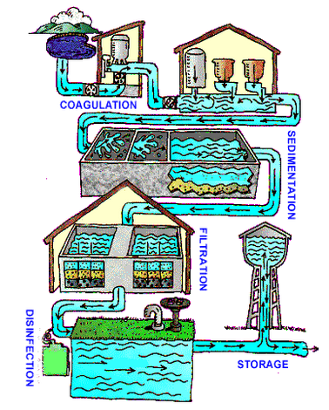
Drinking Water Treatment System
Remove small and large sediments from water
Water forced through filters to remove smallest particles
Removal of biological contaminants

