Slide 1
Igneous Rocks

Slide 2
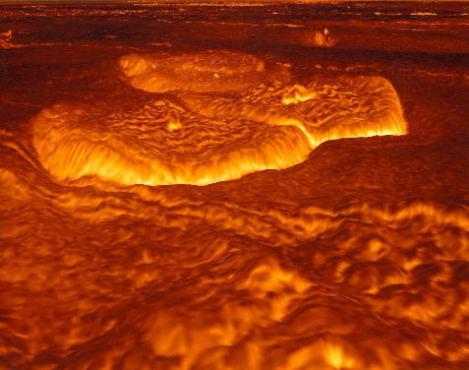
Forming Igneous Rocks
Igneous rocks are formed from the cooling of liquid rock.
Two things will determine which igneous rock
How fast it cools
Composition of melted rock

Slide 3
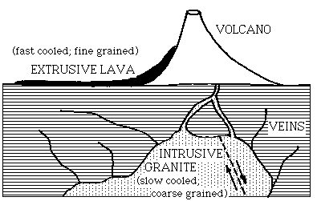
Magma vs. Lava

Slide 4
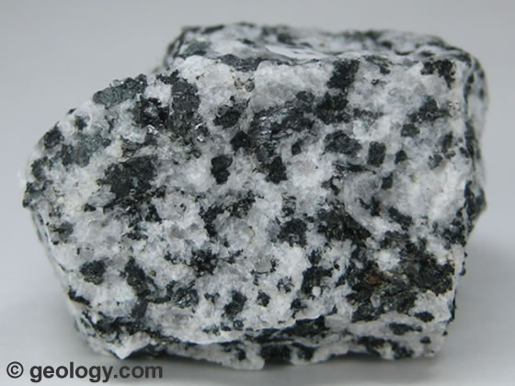
Intrusive vs. Extrusive
Igneous rocks can either form deep within the Earth or near/on the surface.
Intrusive igneous rocks form deep beneath the surface andhave been cooling for millions of years. These rocks are characterized by large crystals. Ex. Granite

Slide 5
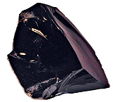
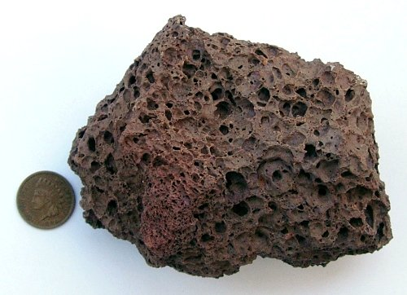
Intrusive vs. Extrusive
Extrusive igneous rocks form on the surface of the earth.
When lava erupts out of a volcano it cools rapidly and there is little to no crystal growth.
Ex. Obsidian, pumice

Slide 6
Texture
Texture deals with how big the crystals are in an igneous rock.
4 Textures
Coarse-Grained: Large crystals, slow cooling
Porphyritic: Both large and small crystals, slow cooling with different minerals
Fine-Grained: Small crystals, fast cooling
Glassy: No crystals, instant cooling

Slide 7
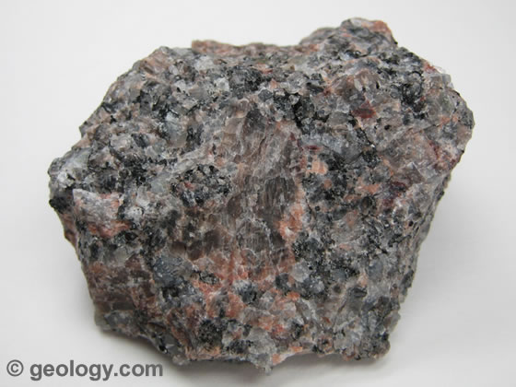
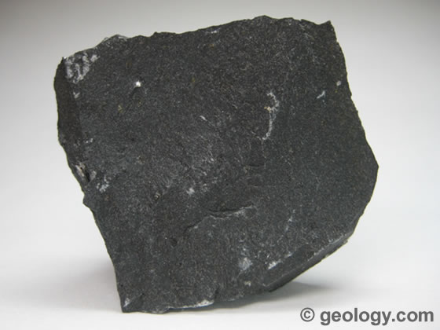
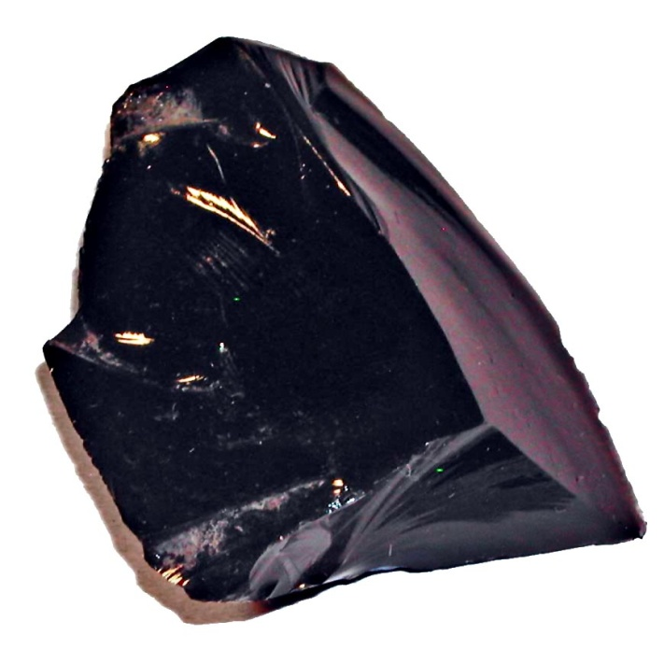
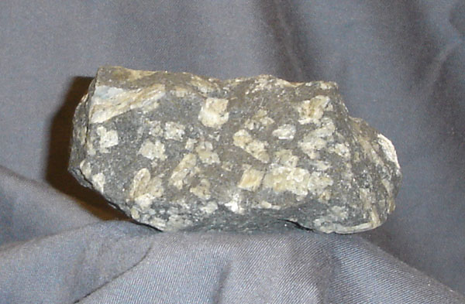

Slide 8
Composition
The composition deals with the chemical make-up of the rock. Silicates are the most common minerals on earth.
How much silica does a rock have????
Felsic (light)- rock made up mostly of silicates
over 65% silica
Andesitic (medium)- rock that is half dark/light
between 55-65% silica
Mafic (dark)- rock that is rich in Fe and Mg
Between 45-55% silica
Ultramafic- rocks rich in Fe and Mg
Under 45% silica

Slide 9
