Slide 1
Astronomy
Origin of the Galaxy and Solar System

Slide 2
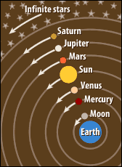
History of Astronomy
The Greeks had a geocentric view—they thought the Earth was a sphere that stayed motionless at the center of the universe.
http://countinfinity.blogspot.com/2010/09/ptolemys-theory.html

Slide 3
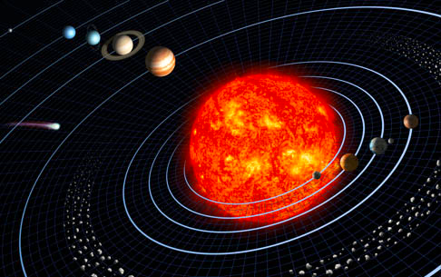
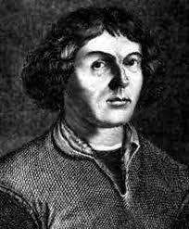
More history
Aristarchus was the first Greek to believe in the heliocentric model—that the Earth and other planets orbit the sun.
Modern astronomy started with Nicolaus Copernicus.
http://newswatch.nationalgeographic.com/2010/02/25/element_112_gets_a_planetary_n/

Slide 4
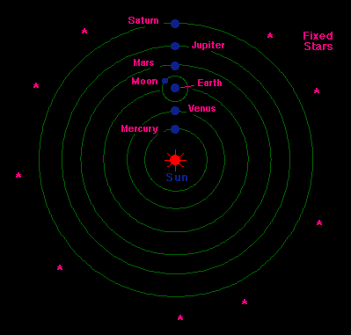
What is a heliocentric system?
Copernicus proposed a heliocentric view of the solar system—to explain the motion of the planets.

Slide 5
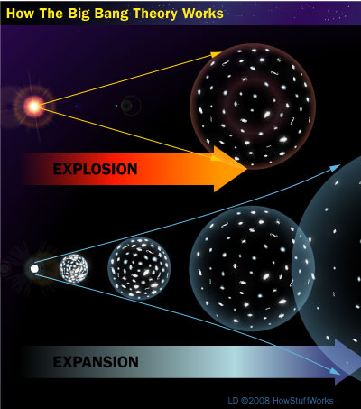
How did the universe begin?
The current understanding of the how the universe began is described by the Big Bang Theory—it wasn’t big and there wasn’t a bang!
http://science.howstuffworks.com/dictionary/astronomy-terms/big-bang-theory1.htm

Slide 6
More on the Big Bang Theory
You Tube video explaining the big bang theory:
http://www.youtube.com/watch?v=zV6aQbnHSRo
The theory states: the universe began from an initial point or singularity which has expanded over billions of years to form the universe as we now know it today.

Slide 7
What’s happening to the universe now?
The universe we live in is expanding.
We know this because we see galaxies and groups of galaxies steadily moving apart in the universe.
This expansion has been occurring since the universe was formed 14 billion years ago.

Slide 8
How do we know that the stars are moving apart?
Using the Doppler effect. Stars moving away from an observer appear red. Stars moving toward an observer appear blue.

Slide 9
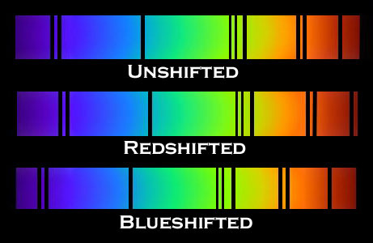

Slide 10
Doppler Effect
Change in wavelength of a wave from a source as it moves away from or toward an object.
When a light source is moving toward the observer, the wavelengths shorten.
When a light source moves away from the observer, the wavelengths lengthen.

Slide 11
What is nebular theory?
Nebular theory is the theory of how star systems were formed. It is the most widely accepted scientific explanation of how stars came to emerge from the cosmos.
Gaseous clouds—nebulae, which slowly rotate, gradually collapse and flatten due to gravity and eventually form stars and planets.
http://www.nowykurier.com/toys/gravity/gravity.html

Slide 12
Solar Nebular Theory
All Solar systems start as clouds of gas and dust called nebulae
Gravity and Centrifugal Rotation compress dust into objects (stars, moons, planets etc.)

Slide 13
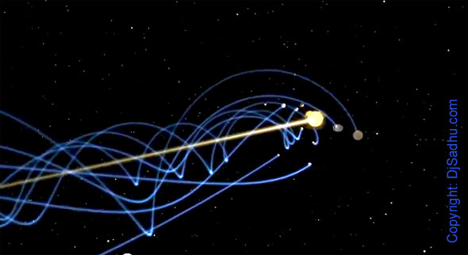
The Earth revolves around the Sun

Slide 14
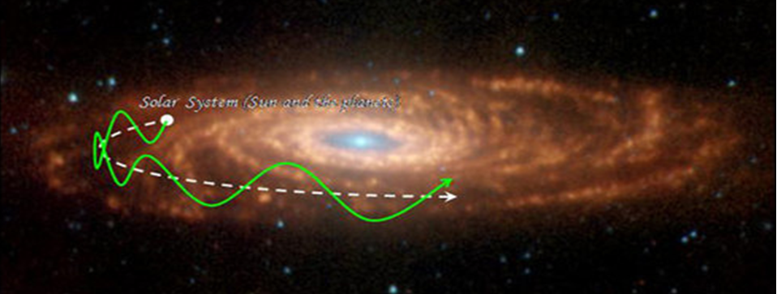
The solar system revolves around galactic center

Slide 15
Galaxies move away from each other in an expanding universe

Slide 16
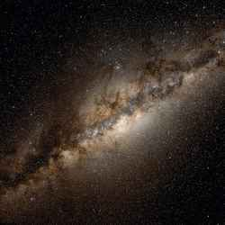
What is the difference between the Solar System, Galaxy, and Universe?
Basically SIZE is the biggest distinction.
We live on planet Earth which is part of our local Solar System.
Our Solar System includes the Sun and everything that orbits the Sun.
Our Sun, is just one Star in the Milky Way Galaxy.
The Milky Way Galaxy is just one Galaxy in the Universe.

